Slide 1
WELLBEING
ALL ABOUT RESILIENCE

Slide 2
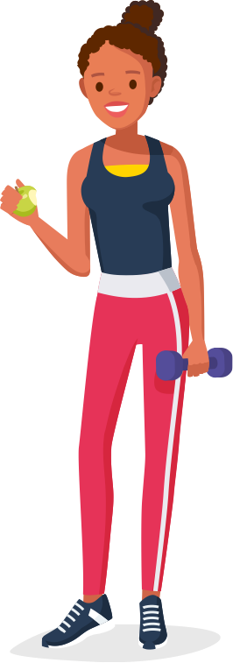
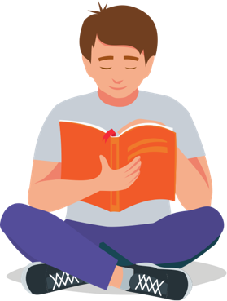
WHAT ARE WE GOING TO LEARN?
In this lesson, we’ll explore various factors that can affect our feelings and how to know when to seek help. We’ll also explore how to deal with setbacks, build resilience, and improve our overall wellbeing.

Slide 3
RESPECT. YOUR RULES.
Today, we’re going to be talking about sensitive topics. It’s really important that we all show each other respect. Use some of the words below to write your own three rules that you’d like everyone to follow.
HEAR
RESPECT
KIND
SENSITIVITY
EMPATHY
LISTEN
UNDERSTAND
SPEAK
Let’s share and agree on our ground rules.

Slide 4
STARTER ACTIVITY
HIGHS AND LOWS

Slide 5
HIGHS AND LOWS
On a sticky note or white board, draw one image to represent a high mood and another for a low mood. It could be something that represents the feeling itself, or perhaps something that causes the feeling.
Share the images with someone else. Can they guess which is which and what they represent?

Slide 6
ACTIVITY 1
WHAT AFFECTS THE
WAY WE FEEL?

Slide 7
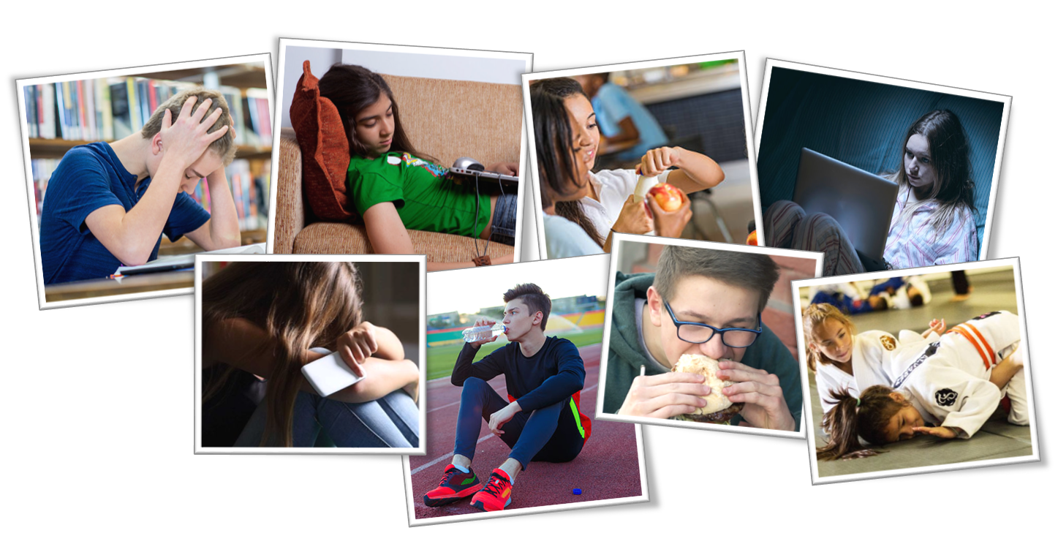

WHAT AFFECTS OUR MOODS?
Look at the images and discuss how these things can affect the way we feel.
Extension:
place them in the order of most positive to most negative impact on mood.

Slide 8
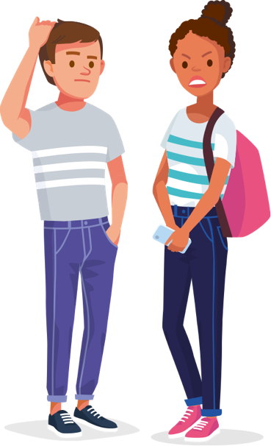
KNOWING WHEN SOMETHING’S WRONG
Having a range of feelings is part of everyday life.
But there are times when certain ongoing feelings can be an early sign of mental illness.
On the next slides, look at these people’s symptoms and see if you think this is a sign for concern or not.
What could their friends do to help?

Slide 9
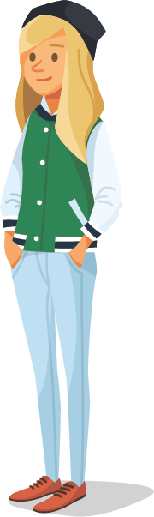
IS IT A WARNING SIGN?
Destiny has been invited to a party at the weekend. She accepted the invitation but, on the day, she doesn’t turn up. This is the fourth time this month she’s avoided meeting up with people.
MAYBE
Avoiding friends or social situations can be an early
sign of depression.
A good friend could talk to Destiny about how she’s
feeling and see whether she would like any support.
Source: https://www.nhs.uk/conditions/clinical-depression/symptoms/

Slide 10
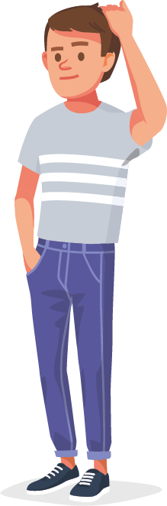
IS IT A WARNING SIGN?
Oli has been feeling under a lot of pressure at school recently. The other day, when he realised he had forgotten to do a piece of homework, his heart started to beat really quickly and he felt like he was struggling to breath. He went to the toilets and managed to calm down after several minutes, but it really scared him.
YES
Oli may be suffering from anxiety and has possibly experienced a panic attack.
Oli’s friend should suggest that he talks to a trusted adult and get support from a professional like his GP or school nurse. They can help him deal with anxiety.
Source: https://www.nhs.uk/conditions/generalised-anxiety-disorder/symptoms/

Slide 11
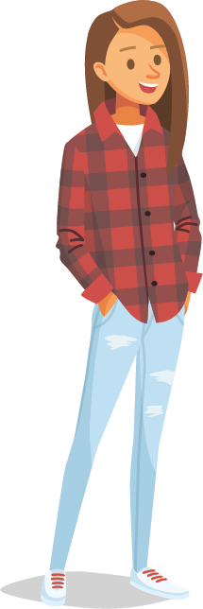
IS IT A WARNING SIGN?
Anita has been experiencing mood swings. One day she is fine, and the next she feels really low. She’s also been feeling really sensitive, especially about the way she looks. Her parents and friends are saying that she’s not herself.
MAYBE
Feeling irritable, upset, miserable or lonely can be a sign of depression. However, mood swings and sensitivity are a normal part of puberty and many teens experience them.
Anita’s friend could keep checking in to see how she is doing. If things get worse or she’s showing any other symptoms of depression, they could suggest she get some help.
Source: https://www.nhs.uk/conditions/clinical-depression/symptoms/

Slide 12
SYMPTOMS OF DEPRESSION
A range of emotions is normal, but if you’re experiencing any or all of these symptoms frequently, it could be an indication of depression.
Not wanting to do things that you previously enjoyed
Avoiding friends or social situations
Eating more or less than normal
Feeling irritable, upset, miserable or lonely
Feeling tired and not having any energy
If you’re regularly experiencing any or all of these symptoms, or anything else doesn’t feel right, speak to a trusted adult and get help.
Source: https://www.nhs.uk/conditions/clinical-depression/symptoms/

Slide 13
SYMPTOMS OF ANXIETY
Another common mental illness is anxiety.
Here are some of the signs to watch out for:
Feeling nervous, on edge, or panicky all the time
Feeling out of control
Having trouble sleeping
Low appetite
Finding it difficult to concentrate
Heart beating really fast or thinking you’re having a heart attack
If you’re regularly experiencing any or all of these symptoms, or anything else doesn’t feel right, speak to a trusted adult and get help.
Source: https://www.nhs.uk/conditions/generalised-anxiety-disorder/symptoms/

Slide 14


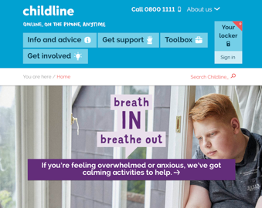
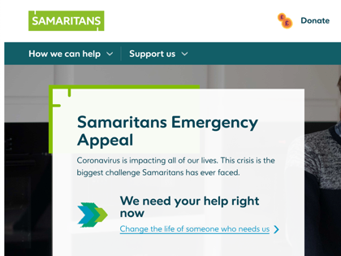
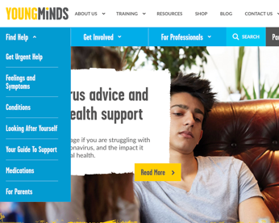
KNOWING WHERE TO GET HELP
If you’re worried about yourself or someone else,
speak to a trusted adult or teacher for advice.
You could also visit one of these websites for further support.
childline.org.uk
samaritans.org
youngminds.org.uk

Slide 15
ACTIVITY 2
BUILDING RESILIENCE

Slide 16
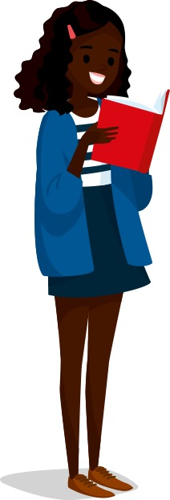
HOW WOULD IT FEEL?
Read the descriptions of people on the following slides.
How do you think they would feel in the situations described?

Slide 17
HOW WOULD IT FEEL?
A heptathlete who takes home a gold medal at her home Olympic games in front of a crowd of roaring fans.

Slide 18
HOW WOULD IT FEEL?
A young boy who is falling behind his classmates at school and whose teacher tells his parents that he has special educational needs.
His school report said that ‘he will never amount to anything’.

Slide 19

HOW WOULD IT FEEL?
A single mum who is jobless and living on benefits
despite having a university degree.

Slide 20
HOW WOULD IT FEEL?
A businessman who revolutionised the vacuum cleaner
with his new bagless model. His products are sold
worldwide and he is worth £16 billion.

Slide 21
HOW WOULD IT FEEL?
A young athlete who suffers a career-threatening injury
just before she is about to make her Olympic debut
and is forced to pull out.

Slide 22

HOW WOULD IT FEEL?
A Nobel-prize winning physicist who creates the most
famous theory of the 20th century and whose name
becomes a new word for genius.

Slide 23
HOW WOULD IT FEEL?
An inventor who has created 5,126
failed prototypes of the same machine.

Slide 24

HOW WOULD IT FEEL?
Author of a series of children’s books that has been translated into 80 languages and sold more than
500 million copies worldwide.

Slide 25
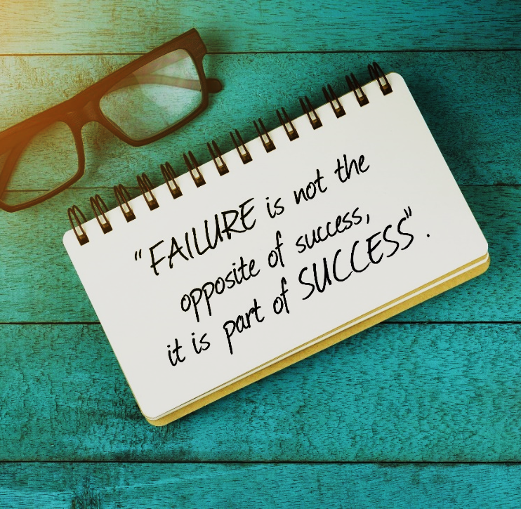
THESE PEOPLE ALL HAD
SOMETHING IN COMMON
They never stopped trying.
In fact, the setbacks they experienced were simply a part of their story on the road to success.
If we look at someone’s whole life, like us, they will have lots of highs and lows at different points – and that’s ok!
Let’s take another look at these moments…

Slide 26

JESSICA ENNIS-HILL
A young athlete who suffers a career-threatening injury just before she is about to make her Olympic debut and is forced to pull out.
A heptathlete who takes home a gold medal at her home Olympic games in front of a crowd of roaring fans.
”I'm proud of the way I've dealt with setbacks. It's hard when you feel down and you think, 'Why is the world doing this to me?' But you have to pick yourself up again. That's what makes you a better athlete.”

Slide 27
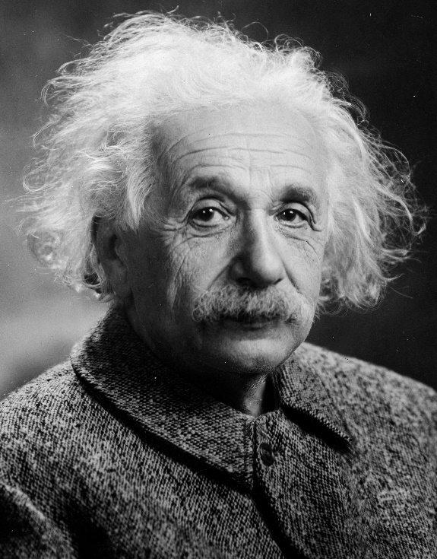
ALBERT EINSTEIN
A young boy who is falling behind his classmates at school, and whose teacher tells his parents that he has special educational needs. His school report said that ‘he will never amount to anything’.
A Nobel-prize winning physicist who creates the most famous theory of the 20th century and whose name becomes a new word for genius.
“You never fail until you stop trying.”

Slide 28
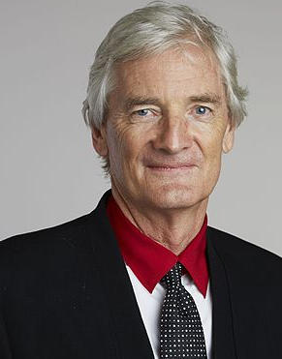
SIR JAMES DYSON
An inventor who has created 5,126 failed prototypes of the same machine.
A businessman who revolutionised the vaccum cleaner with his new bagless model. His products are sold worldwide and he is worth £16 billion.
“Enjoy failure and learn from it. You
can never learn from success.”

Slide 29

JK ROWLING
A single mum who is jobless and living on benefits
despite having a university degree.
Author of a series of children’s books that has been translated into 80 languages and sold more than 500 million copes worldwide.
“It is impossible to live without failing at something, unless you live so cautiously that you might as well not have lived at all – in which case, you fail by default.”

Slide 30
SHOWING RESILIENCE
How do you think we can demonstrate resilience? Discuss and create a mind map.
RESILIENCE An ability to recover from or adjust easily to misfortune or change.

Slide 31
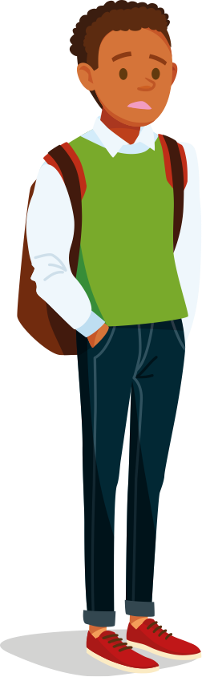
BUILDING RESILIENCE
Use the Building Resilience Activity Sheet to look at some
examples of young people who have experienced a setback.
What lesson could they learn and how could they change their
behaviour in the future? Write the next part of their stories.
Let’s look at the first one together.
THE SETBACK | WHAT LESSON COULD THEY LEARN? | WRITE THE NEXT PART OF THEIR STORY ON THE ROAD TO SUCCESS
MOHAMMED is on his local athletics team and recently ran in a 200m race for the county. He came second to last and was really disappointed. He trains regularly but missed a few sessions before the race to hang out with his friends. His coach says he has great potential.

Slide 32
ACTIVITY 3
SELF-CARE

Slide 33
WHAT IS SELF-CARE?
Have you heard the phrase ‘self-care’ before?
What do you think it means and why is it important?
Self-care means taking the time to look after your own needs and making sure that you are healthy both physically and mentally.

Slide 34
HOW CAN WE PRACTISE SELF-CARE?
There are already people who look after you, like your family or carer.
But what are the things you can do to look after yourself?
Discuss with someone what you could do to show self-care in these areas:
PHYSICAL
HEALTH
DIET
RELAXATION
SELF-
ESTEEM
MENTAL
HEALTH
SCHOOL
WORK

Slide 35

WHAT MAKES YOU FEEL GOOD?
One thing that can help to improve our overall wellbeing is to find
something that we are passionate about and love to do.
It could be sport, music, acting, or any other kind of activity.
What is the thing that you most enjoy doing? Mime the activity
to another person and see if they can guess what it is.

Slide 36

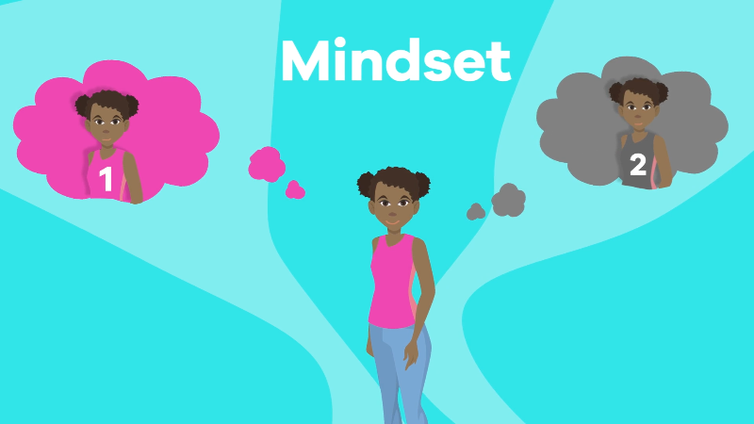

DEVELOPING YOUR PASSION
By regularly pursuing your passion, you will be developing a skill and showing that you can be disciplined.
Not only will this help you build confidence, but you can also use it as evidence to show employers that you’re committed and resilient.
Watch the Fixed Vs Growth Mindset Video to learn more.
Notes:
CLICK TO PLAY

Slide 37
MY PASSION
Use the My Passion Activity Sheet provided to help you create some personal goals in areas you are passionate about.
Extension:
write an advert promoting your passion. How would you persuade someone else to give it a try?

Slide 38
ACTIVITY 4
HELPING OTHERS

Slide 39

HELPING OTHERS
Write a well-being guide for a younger student who is just starting secondary school. You could include some of the following ideas:
Tips for dealing with difficult emotions
How to deal with setbacks
Information on a healthy lifestyle
How to unwind and relax
Where to go for extra help and support

Slide 40
REFLECTION
BUILDING RESILIENCE

Slide 41
BUILDING RESILIENCE
Think of a situation recently where you have had a setback.
What did you learn?
How could you act differently in the future to have a better outcome?

Slide 42
WELLBEING
ALL ABOUT RESILIENCE

