Slide 1
PUBERTY
ALL ABOUT FERTILITY

Slide 2
WHAT ARE WE GOING TO LEARN?
In today’s lesson, we’re going to recap on the changes that happen to male and female bodies during puberty, investigate tampons, understand the process of reproduction, and learn about the role of contraception.

Slide 3
RESPECT. YOUR RULES.
Today, we’re going to be talking about sensitive topics. It’s really important that we all show each other respect. Use some of the words below to write your own three rules that you’d like everyone to follow.
HEAR
RESPECT
KIND
SENSITIVITY
EMPATHY
LISTEN
UNDERSTAND
SPEAK
Let’s share and agree on our ground rules.

Slide 4
STARTER ACTIVITY
WHAT IS PUBERTY?

Slide 5
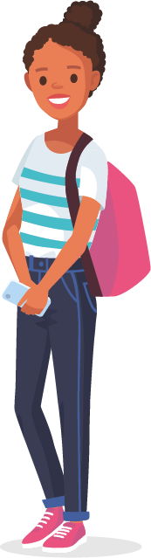

WHAT IS THE DEFINITION OF PUBERTY?
Discuss with a partner but don’t share, yet.

Slide 6
ACTIVITY 1
HOW MUCH DO YOU KNOW ABOUT PUBERTY?

Slide 7
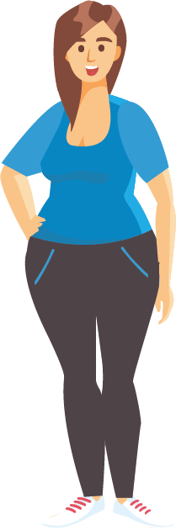
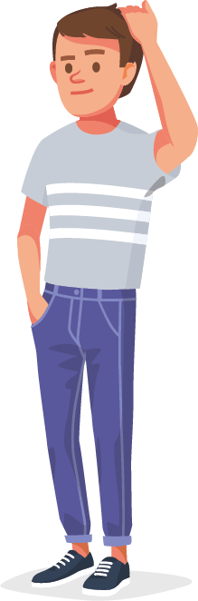
HOW MUCH DO YOU KNOW ABOUT PUBERTY?
In teams, work together to complete the Puberty Quiz Activity Sheet.
There are three rounds.
Round 1 – True or False?
Round 2 – Multiple choice and knowledge recall
Round 3 – Picture round
You have 10 minutes to complete the quiz, then swap your answers with another team to review and mark. Good luck!

Slide 8
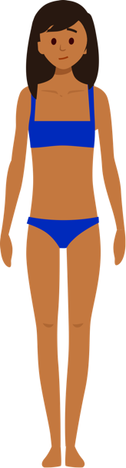


ROUND 1 TRUE OR FALSE?
#1
Puberty is the process where the body goes through a series of changes that prepare it for reproduction.
TRUE!
Puberty is the process where the sexual organs mature. It’s also a time of important brain development too.

Slide 9


ROUND 1 TRUE OR FALSE?
#2
A person’s period usually starts three years after they start developing breasts.
FALSE
On average, people start their period two years after they notice breast development. Remember, everyone is different so don’t worry too much about what is happening to others.

Slide 10
ROUND 1 TRUE OR FALSE?
#3
All males experience wet dreams during puberty.
FALSE
Many males will experience wet dreams where they ejaculate in their sleep, but it doesn’t happen to everyone, and that’s not a problem.

Slide 11

ROUND 1 TRUE OR FALSE?
#4
Hormones, chemical messengers that affect different parts of the body, lead to the changes at puberty.
TRUE!
During puberty, two parts of the brain called the hypothalamus and the pituitary gland start making a lot more hormones. Hormones like testosterone, progesterone and oestrogen cause changes in different parts of the body.

Slide 12
ROUND 1 TRUE OR FALSE?
#5
Males and females have different hormones
FALSE
Males and females have the same hormones, but in different quantities. Males have much more testosterone and females have more oestrogen and progesterone.

Slide 13

ROUND 1 TRUE OR FALSE?
#6
There’s nothing you can do about body odour once you reach puberty; it’s just part of life.
FALSE
Body odour is not caused by sweat, but by bacteria on the skin that break down the sweat. Using deodorant, washing every day and after exercise, and wearing natural fabrics all help prevent body odour.

Slide 14
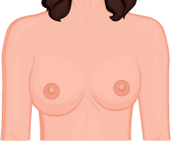
ROUND 1 TRUE OR FALSE?
#7
Males and females develop breasts at puberty.
TRUE!
Around half of males also experience breast growth at puberty due to an imbalance of hormones. It usually goes away with time, but if you are concerned, speak to a GP.

Slide 15
ROUND 1 TRUE OR FALSE?
#8
Tampons shouldn’t be used until you’ve lost your virginity.
FALSE
Tampons can be used from your very first period if you want to, although many find it easier to use pads to begin with.

Slide 16
ROUND 1 TRUE OR FALSE?
#9
Only girls have periods.
FALSE
Trans boys or non-binary people also have periods.

Slide 17
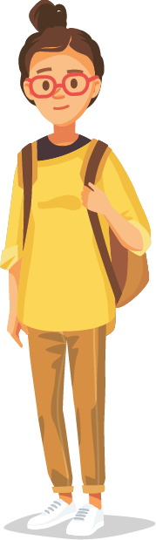

ROUND 1 TRUE OR FALSE?
#10
Mood swings only happen to females
when they have PMS.
FALSE
Mood swings affect males and females at puberty and can happen at any time.
Give the team a mark out of 10 for this round

Slide 18
ROUND 2 MULTIPLE CHOICE AND KNOWLEDGE RECALL ROUND
#1
What is the age range at which puberty typically begins?
10 to 13
7 to 12 for females, and 9 to 14 for males
8 to 14
9 to 15 for females, and 10 to 16 for males
Everyone starts puberty at a different time following their own body clock. If you’re first or last, it can be difficult, but most people catch up in the end. Speak to your GP if you’re worried about it starting early or late.

Slide 19
ROUND 2 MULTIPLE CHOICE AND KNOWLEDGE RECALL ROUND
#2
What is the correct order of the phases of the menstrual cycle?
Pre-ovulation, Menstruation, Ovulation, Pre-Menstruation
Pre-ovulation, Ovulation, Pre-Menstruation, Menstruation
Menstruation, Ovulation, Pre-Menstruation, Pre-ovulation
Menstruation, Pre-ovulation, Ovulation, Pre-Menstruation
The menstrual cycle is the process whereby a mature egg is released for fertilisation by a sperm. If this does not happen, the lining of the uterus breaks down leading to menstruation – or a period.

Slide 20
ROUND 2 MULTIPLE CHOICE AND KNOWLEDGE RECALL ROUND
#3
What are the common symptoms of PMS (Pre-Menstrual Syndrome)?
Breast tenderness, headaches, backaches, bloating, moodiness, cramps, and food cravings.
Just cramps.
Headaches, backaches, bloating, and cramps.
There are no symptoms; it’s all in the head.
PMS often occurs 1 to 2 weeks before menstruation starts. The symptoms can be difficult to manage. A hot water bottle and painkillers can help with cramps. Gentle exercise or a warm bath can help too.

Slide 21
ROUND 2 MULTIPLE CHOICE AND KNOWLEDGE RECALL ROUND
#4
On reaching puberty, how many sperm cells will a healthy male produce?
Up to 1 million per day
40 to 70 million per day
70 to 150 million per day
Males are born with all of the sperm cells they will ever have.
That’s right! Males produce between 70 to 150 million sperm cells a day when puberty starts. This amount gradually reduces as they age. By contrast, women are born with 1 to 2 million eggs, and by the start of puberty this number has reduced to around 300,000 and continues to decline.

Slide 22

ROUND 2 MULTIPLE CHOICE AND KNOWLEDGE RECALL ROUND
#5
Name four physical or emotional changes that happen at puberty to:
MALES
FEMALES
BOTH
Breasts can grow
Adam’s apple enlarges
Voice cracks and gets deeper
Shoulders get larger and body gets more muscular
Chest hair may appear
Penis and testicles grow
Erections and ejaculation may begin
Breasts start to grow
Vaginal discharge begins
Hips and thighs broaden
Labia may change
Periods start
Emotions and feelings may seem stronger
Brain development improves the way you think and understand
New feelings of attraction may begin
You grow taller
Skin gets oilier and spots may appear
Sweating increases, body develops own odour
Hair grows: face, armpit, leg & pubic
Give the team a mark out of 16 for this round
Notes:
Give the team a mark out of 16 for this round

Slide 23
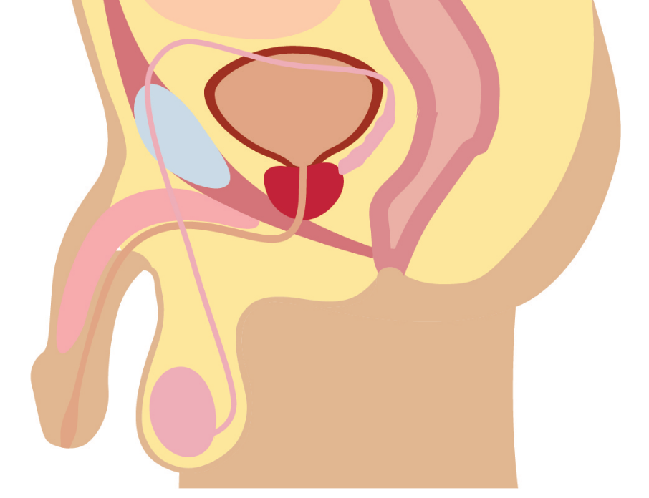
ROUND 3 PICTURE ROUND
#1
Bladder
Prostate gland
Rectum
Urethra
Anus
Penis
Testis
Scrotum
Give the team a mark out of 8 for this round
Notes:
Give the team a mark out of 8 for this round

Slide 24
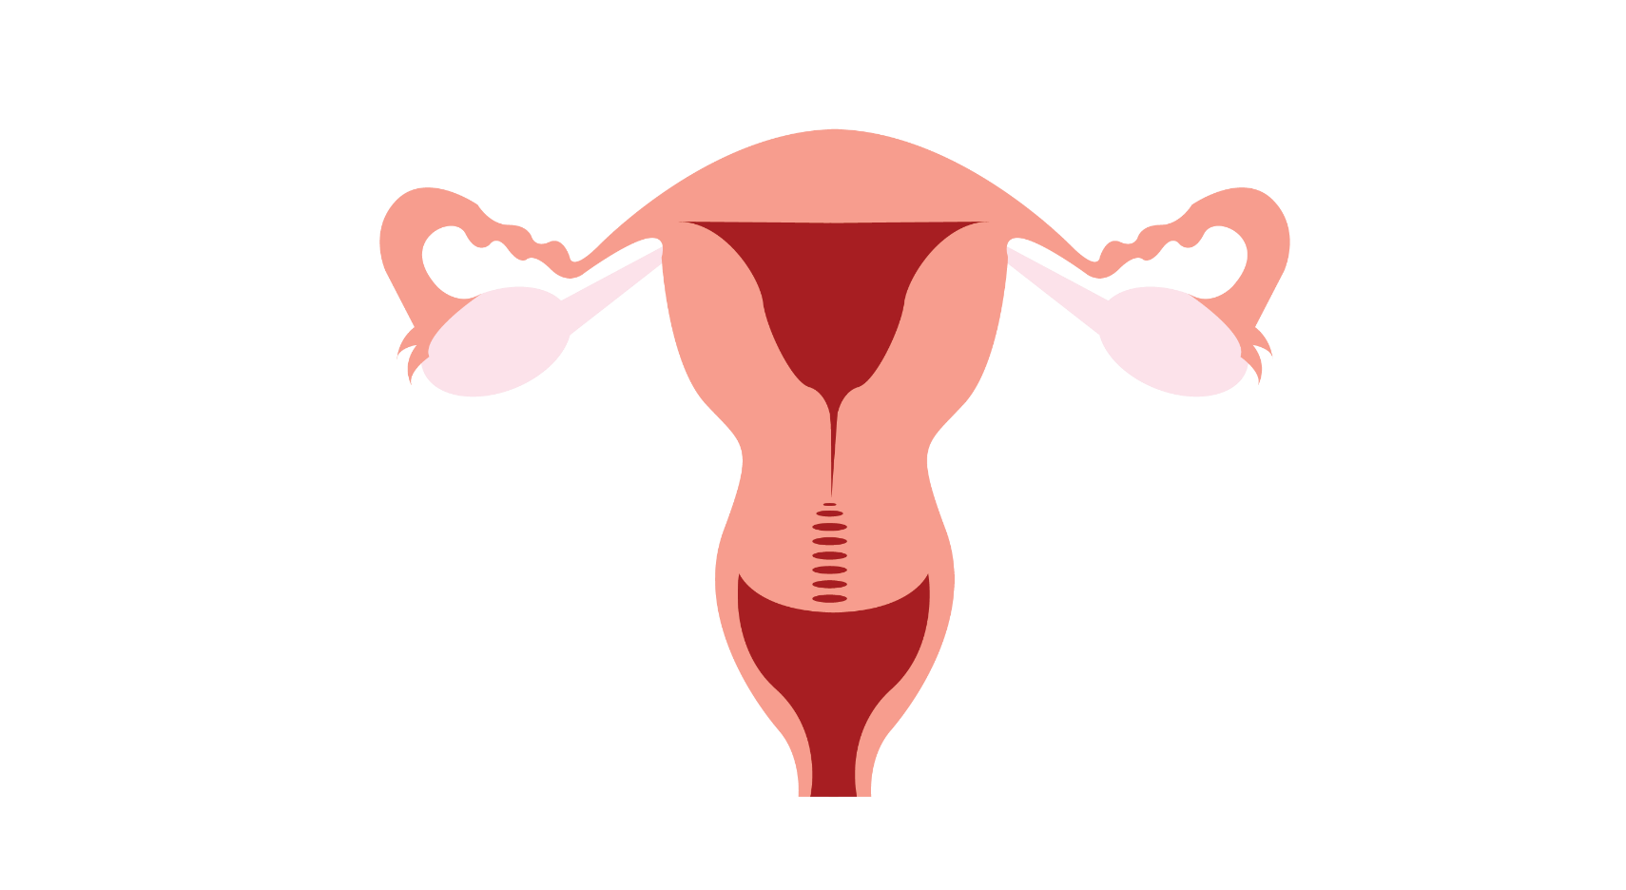
ROUND 3 PICTURE ROUND
#2
Uterus
Fallopian
tube
Ovary
Cervix
Vagina
Give the team a mark out of 5 for this round
Notes:
Give the team a mark out of 5 for this round

Slide 25
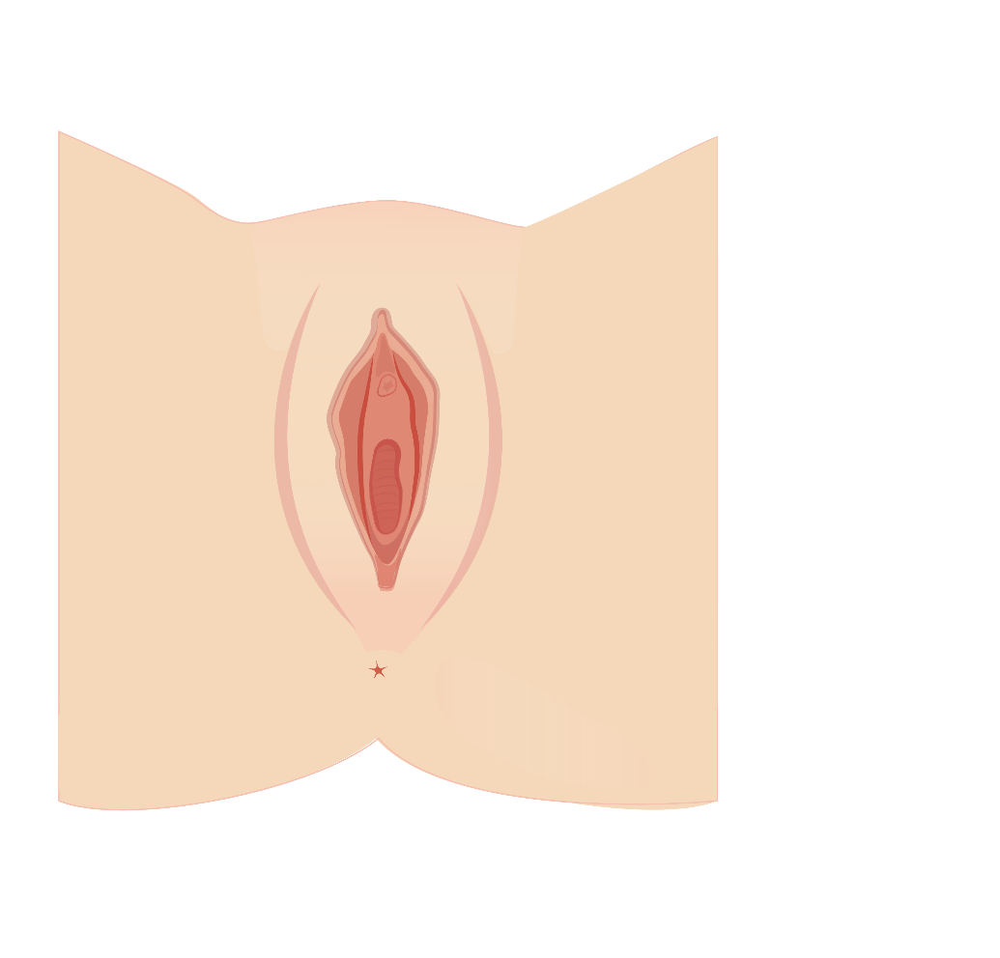
ROUND 3 PICTURE ROUND
#3
Vulva
Clitoris
Labia
Urethral opening
Vaginal opening
Anus
Give the team a mark out of 6 for this image and a total of 19 for the round
Notes:
Give the team a mark out of 5 for this round

Slide 26
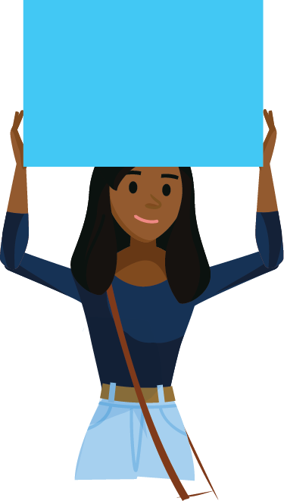
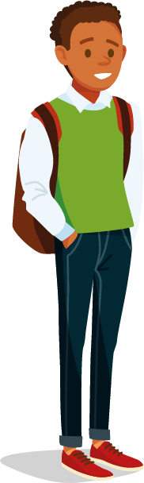


TOTAL SCORES
Add up the team’s total scores, and let’s see who are the most clued up team so far!
And the
winner is…
Notes:
Give the team a mark out of 5 for this round

Slide 27

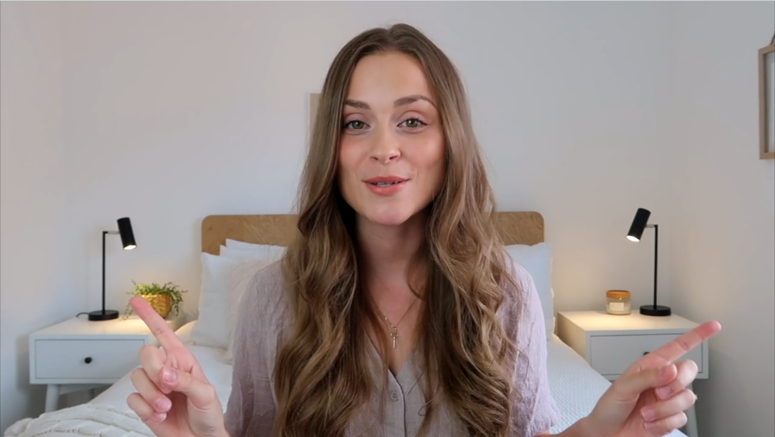

PUBERTY AND PERIODS
Maybe you’re a puberty expert, or perhaps you still have a few things you’d like to know. In this video, Jade Billington talks about her experiences…
Notes:
CLICK TO PLAY

Slide 28
ACTIVITY 2
INVESTIGATING TAMPONS

Slide 29

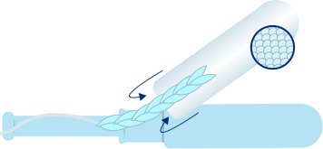
TAMPONS
A tampon is made from soft materials, that you insert in your vagina.
You can wear tampons while doing sport or even swimming as they absorb menstrual fluid before it leaves your body.
Remember, tampons go in your vagina (not your urethra). That means you can still pee while wearing a tampon.
Absorbent core
Provides protection by absorbing and storing menstrual fluid
Overwrap
Thin layer around absorbent core that helps with smooth removal
Cord
Used to remove the tampon
Applicator
Helps you comfortably insert the tampon

Slide 30
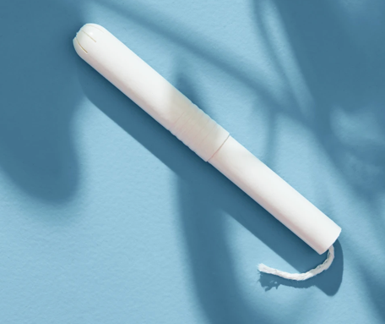
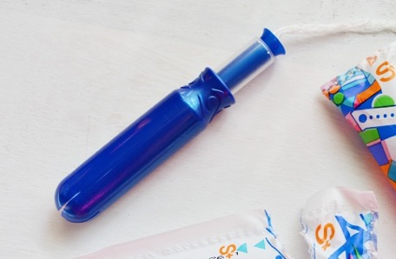
CHOOSING THE RIGHT TAMPON
Tampons come in different absorbencies for different flows. When your flow is heavier, normally at the start of your period, you can use a more absorbent tampon.
Some tampons have applicators made from different materials like plastic or cardboard.
Some females find applicators easier to use, especially smooth plastic applicators like Tampax Pearl.

Slide 31
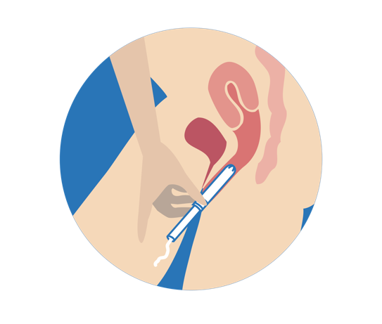
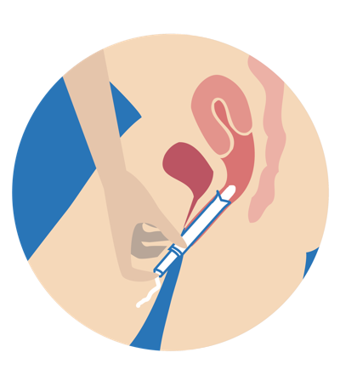
USING AN APPLICATOR TAMPON
Follow these easy steps on how to insert a tampon.
Wash your hands.
Unwrap the tampon. Use the lowest absorbency for your flow.
Find a comfortable position.
If you’re using a compak tampon, pull the applicator out first so it’s fully extended.
Gently slide the applicator all the way into your vagina, until your fingers touch your body.
Push the small tube into the bigger tube to insert the tampon.

Slide 32
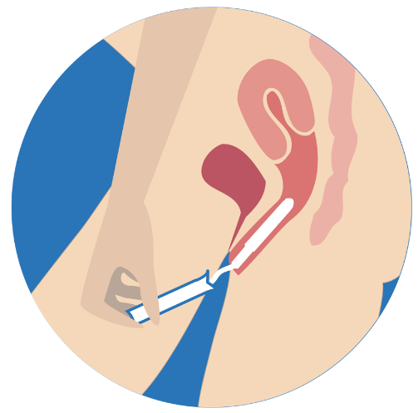
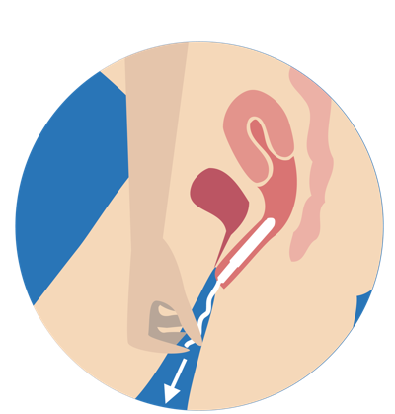

USING AN APPLICATOR TAMPON
Follow these easy steps on how to insert a tampon.
To remove the applicator, firmly hold on to the outer tube and pull it out gently, leaving the tampon inside your body and the string hanging outside. Put the applicator in the bin.
When it's time to remove your tampon, simply pull on the string and your tampon should slide right out. Never leave your tampon in for more than 8 hours.
Wrap and bin the used tampon; never flush.
Wash your hands afterwards too.

Slide 33

TSS - WHAT IS IT?
TSS – or Toxic Shock Syndrome – is a rare condition that can be fatal. Anyone can get TSS but it has been linked with tampon use, so it’s important to know the signs.
TSS is treatable, but the earlier you catch it the better. Here’s what you need to watch out for:
• Sudden high fever (usually over 39°C)
• Dizziness
• Vomiting
• Muscle ache
• Diarrhoea
• Fainting
• Sunburn-like rash
If you think you may have TSS, you should talk to a trusted adult and see a doctor

Slide 34
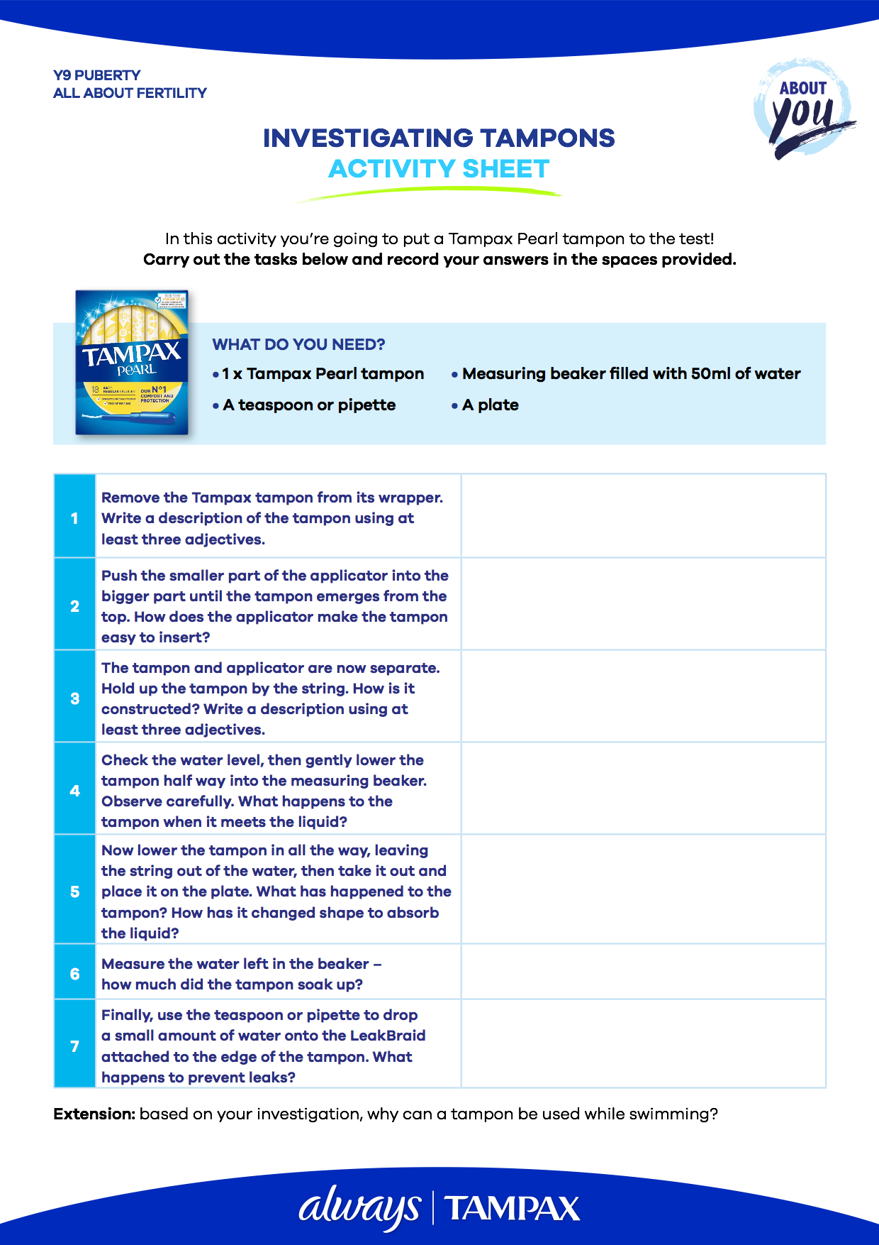

LET’S INVESTIGATE HOW TAMPONS WORK
You’ll need:
the Investigating Tampons Activity Sheet
a Tampax tampon
50ml of water in a measuring beaker
a teaspoon or pipette
a plate
Extension: based on your investigation, why can a tampon be used while swimming?

Slide 35
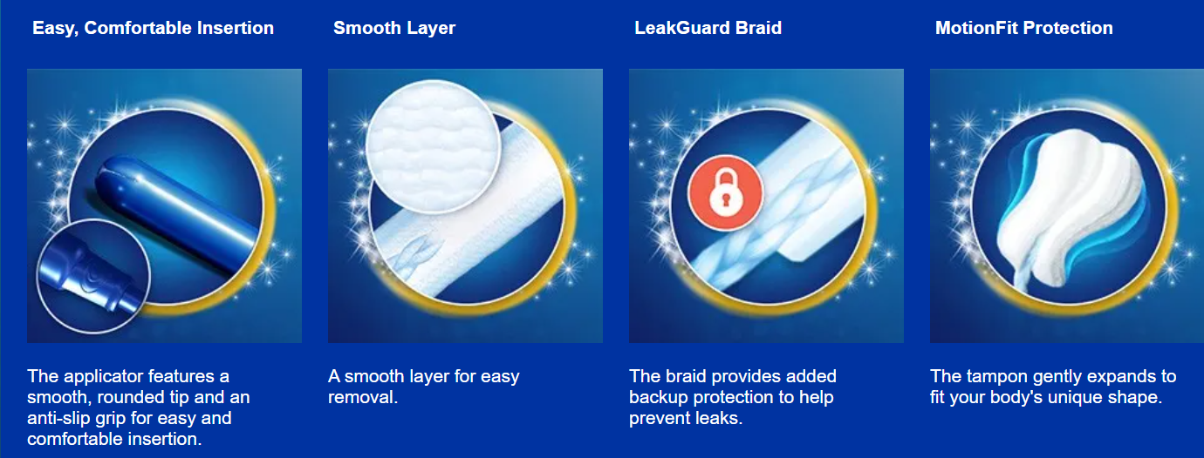
DID YOU SPOT THESE FEATURES?

Slide 36
ACTIVITY 3
REPRODUCTION AND
CONTRACEPTION

Slide 37

REPRODUCTION – THE FACTS
A healthy menstrual cycle is a sign of fertility. Each month, when an egg is released, females enter the fertile window when they are most likely to become pregnant. Don’t forget that pregnancy can also occur outside of this fertile window.
Let’s recap on the menstrual cycle and reproduction, then look at the different methods of contraception and how these can be used to prevent a pregnancy until it is wanted.

Slide 38
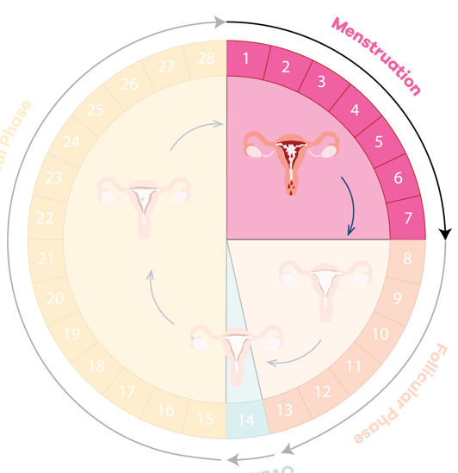
THE MENSTRUAL CYCLE
Each month, females move through the menstrual cycle. It has four phases.
1. Menstruation
The menstrual period, which is made of endometrial tissue, blood and other fluids, exits the uterus through the cervix and vagina.

Slide 39
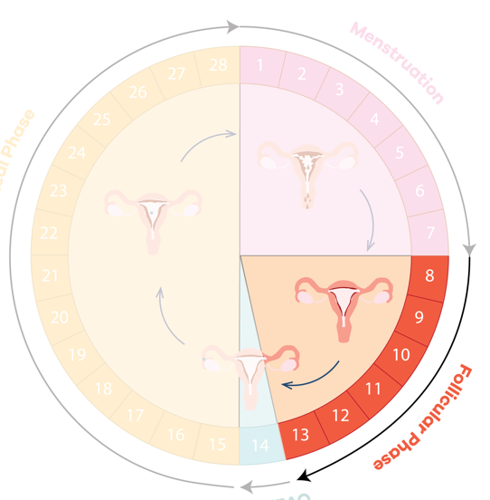
THE MENSTRUAL CYCLE
Each month, females move through the menstrual cycle. It has four phases.
2. Pre-ovulation
Each ovary holds thousands of eggs and every month rising hormones cause the ovary to produce a mature egg. During this time, oestrogen causes the endometrium (lining of the uterus) to get thicker.

Slide 40
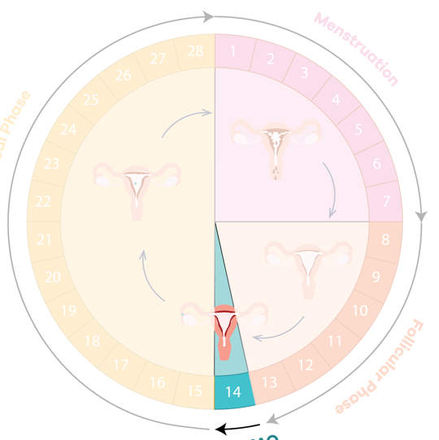
THE MENSTRUAL CYCLE
Each month, females move through the menstrual cycle. It has four phases.
3. Ovulation
Ovulation occurs when a mature egg is released from an ovary. The egg travels along the fallopian tube to the uterus. If a sperm fertilises the egg, the cells can begin to form a pregnancy. Around the time of ovulation there may be an increase in vaginal discharge.

Slide 41
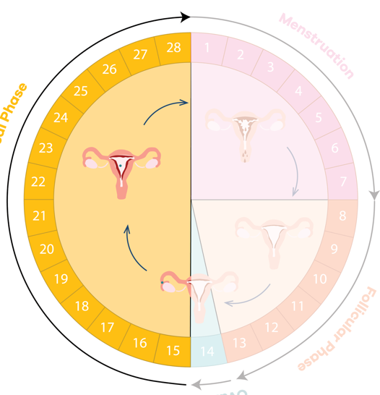
THE MENSTRUAL CYCLE
Each month, females move through the menstrual cycle. It has four phases.
4. Pre-menstrual
The endometrium is thick and ready to receive a fertilised egg, but if fertilisation does not happen, the lining is no longer needed. As a result, hormone levels change and the lining starts to break down. These changes may cause symptoms known as PMS.

Slide 42
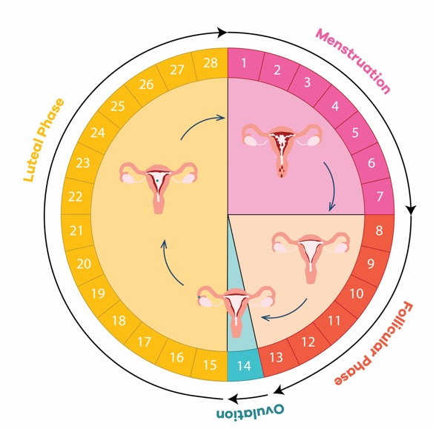
FERTILISATION AND IMPLANTATION
Every month, pregnancy can occur if a sperm enters into the vagina and travels through the uterus to meet an egg in the fallopian tube.
If fertilised, the egg may then implant into the lining of the uterus.
If implantation occurs, the lining of the uterus (endometrium) is not shed, and a baby starts to develop.
The first sign of pregnancy for most women is a missed period.
Menstruation
Pre-menstrual
Pre-ovulation
Ovulation

Slide 43
FERTILISATION AND IMPLANTATION
Understanding the fertile window is important in helping to prevent, and perhaps one day plan, a pregnancy.
Females are most fertile a few days either side of ovulation – the point at which an egg is released.
This is known as the fertile window, when the chance of conception is high.
However, if you want to avoid a pregnancy, you should use contraception any time you have sex as it’s still possible to conceive outside this window, even during your period.
Menstruation
Pre-menstrual
Pre-ovulation
THE FERTILE WINDOW
Ovulation

Slide 44
FERTILISATION AND IMPLANTATION
Other factors like stress and illness can affect your cycle. It can be worrying when your period is late but isn't always due to pregnancy.
If you’re worried, consult a trusted adult or a GP.
Keep track of your period or use an app to understand your cycle better, and remember: always use contraception regardless of when your fertile window is.
Menstruation
Pre-menstrual
Pre-ovulation
THE FERTILE WINDOW
Ovulation

Slide 45
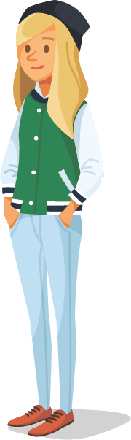
CONTRACEPTION AND CONSENT
Contraception not only prevents pregnancy, it also protects you and your partner from STIs – Sexually Transmitted Infections.
The legal age for having sex in the UK is 16 – this is called the age of consent - although many people will not be ready for sex until later.
Everyone will be ready at different times. Once you have turned 16 it is your choice if or when you want to engage in sex.
You should never feel pressured into having sex or doing anything you don't want to do, ever.

Slide 46
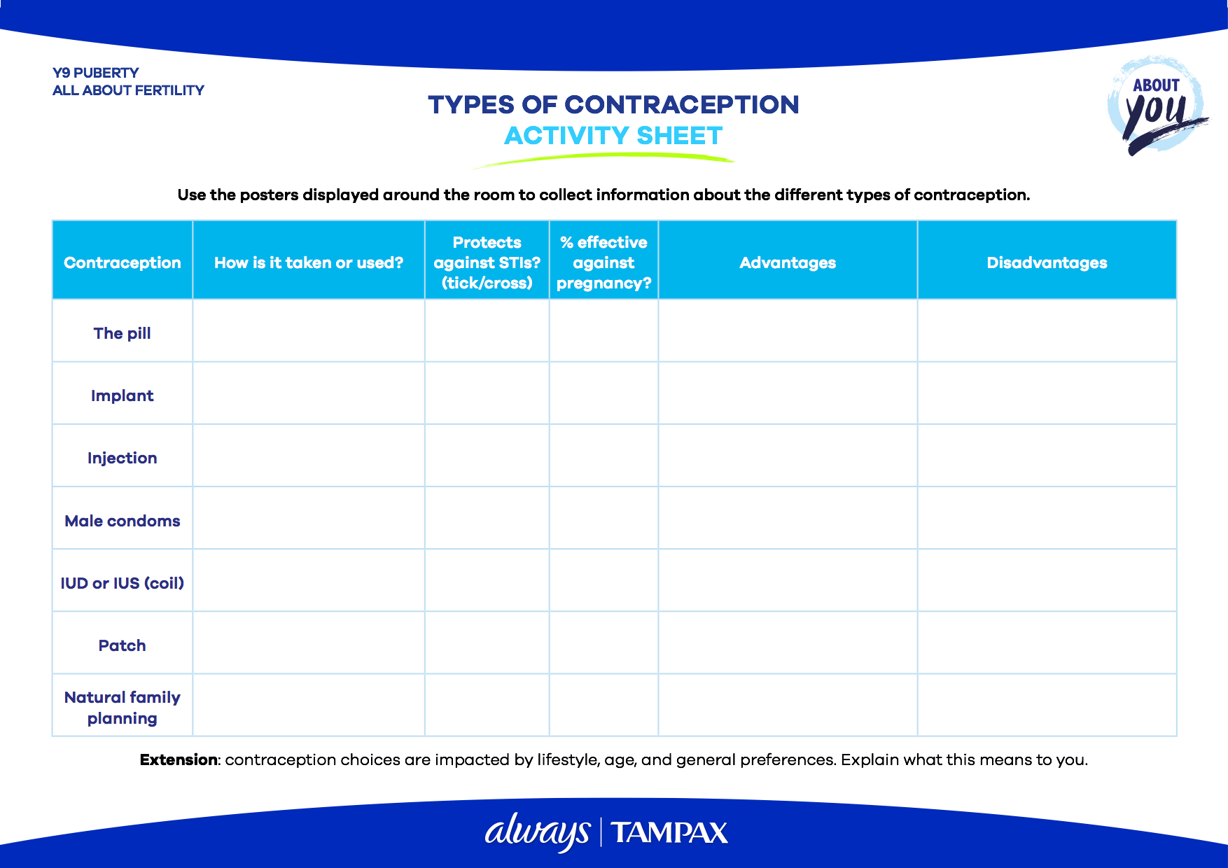
CONTRACEPTION INVESTIGATION
Around the room you will find Contraception Posters with information on different types of contraception.
Fill in the Types of Contraception Activity Sheet with information about the different types of contraception and their features.
You have 15 minutes to fill in as much as you can.
Extension: contraception choices are impacted by a number of factors. Explain what this means to you?

Slide 47
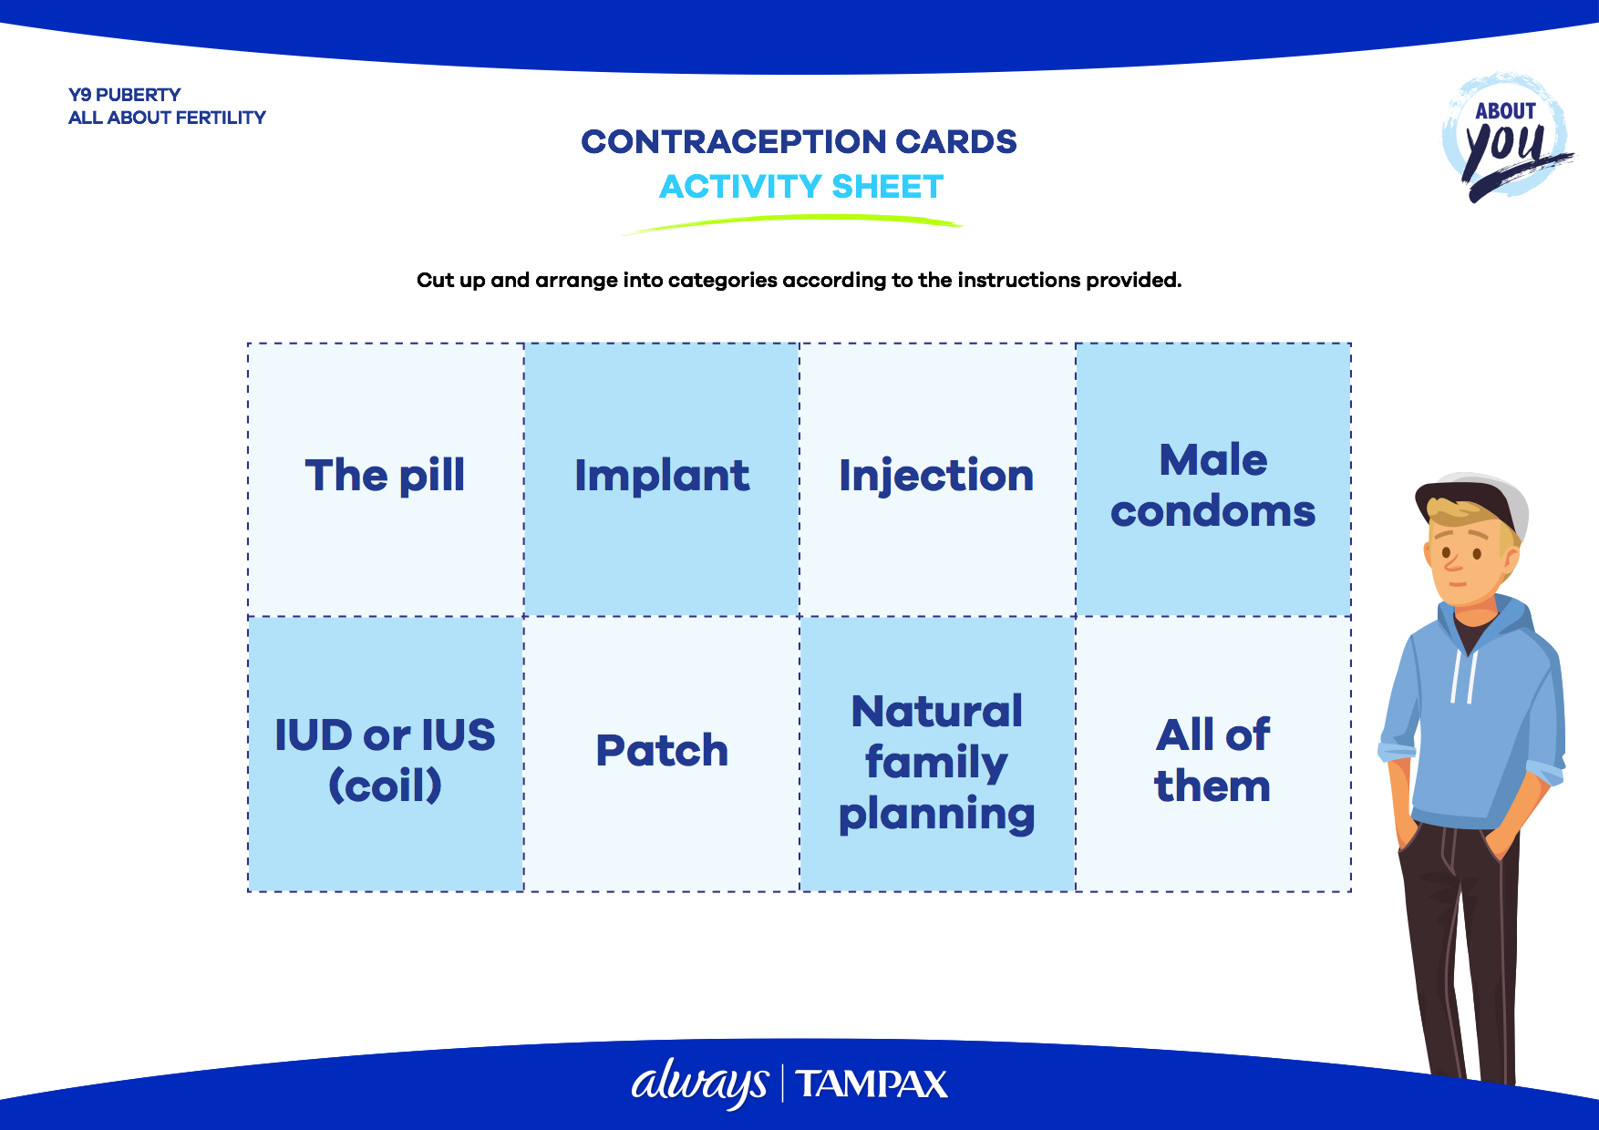
CONTRACEPTION REVIEW
In groups, cut up a set of Contraception Cards listing the names of the different contraceptives you have explored.
Sort these into the categories given on the next slides using the information you have collected.

Slide 48

CONTRACEPTION REVIEW
1. Protects against pregnancy
All contraceptives protect against pregnancy. However, remember that they must be taken or administered correctly for them to be effective.
All of
them

Slide 49
CONTRACEPTION REVIEW
2. Protects against STIs
Condoms are the only contraceptive that protects against STIs. You should always use condoms with another form of protection to be safe.
Male condoms

Slide 50
CONTRACEPTION REVIEW
3. Used by females
Even though many contraceptives are used by females, it is always the responsibility of both partners. It’s down to you to stay safe and responsible.
Implant
The pill
Natural Family Planning
Patch
IUD (coil)
Injection

Slide 51
CONTRACEPTION REVIEW
4. Taken daily
The pill is taken at the same time every day, so it’s important to be organised. With some pills, you take a break for 7 days during which time you will experience period-like bleeding. You are still protected during this time.
The
pill

Slide 52
CONTRACEPTION REVIEW
5. Is a form of Long Lasting Reversible Contraceptive (LARC), meaning that it doesn’t depend on you remembering to take or use it to be effective
All these are forms of LARC. They are highly effective in preventing pregnancy and allow fertility to return when you’re ready. Unlike the pill, you don’t have to remember to take them daily, but you do need to know when they run out.
Implant
Injection
IUD
(coil)

Slide 53
CONTRACEPTION REVIEW
6. Need to be used every time sexual intercourse takes place to prevent STIs and pregnancy
You should use a condom every time sexual intercourse takes place to prevent STIs and pregnancy. You should never reuse a condom. If a condom is damaged, do not use it. If it comes off while in use, you should seek emergency contraception.
Male
condoms

Slide 54
CONTRACEPTION REVIEW
7. Is 99% effective against pregnancy
Only the male condom is slightly less effective at preventing pregnancy (98%). It is advised to use condoms along with another form of contraception.
Implant
The pill
Natural Family Planning
Patch
Injection
IUD (coil)

Slide 55
CONTRACEPTION REVIEW
8. Affects menstruation
These contraceptives can affect periods in different ways. It may be necessary to experiment with different types of pill or contraception to find what suits you best.
Implant
The pill
Patch
IUD (coil)
Injection

Slide 56
CONTRACEPTION REVIEW
9. Can be affected by other medicines
Always check with your doctor if you’re taking other medicines.
The pill
Implant

Slide 57

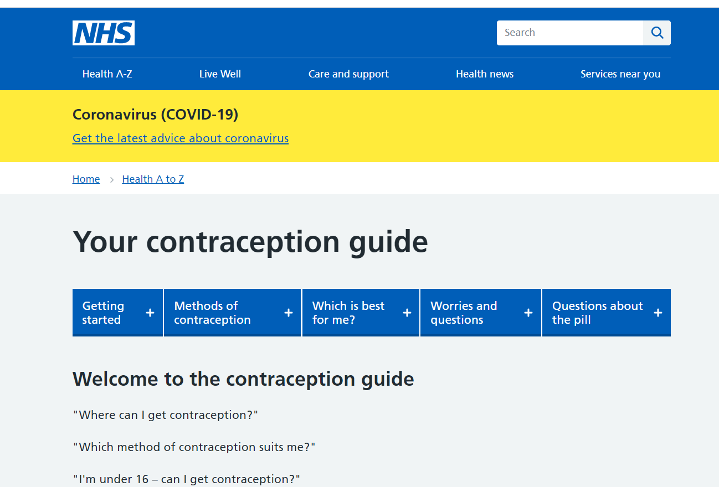

WANT TO KNOW MORE?
You could talk to a trusted adult or your GP. You can also find detailed information about contraception on these sites:
nhs.uk/conditions/contraception/
sexwise.fpa.org.uk/contraception

Slide 58
ACTIVITY 4
CONTRACEPTION CAMPAIGN

Slide 59

CONTRACEPTION CAMPAIGN
Create your own advert for contraception use. You should include different methods and persuasive reasons for using contraception - make it catchy!

Slide 60
REFLECTION
ANY QUESTIONS?

Slide 61


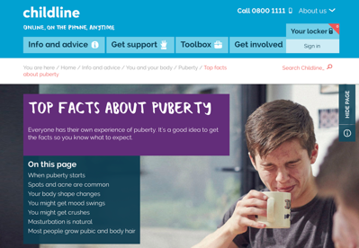

REFLECTION
Is there anything else you’d like to know about puberty, menstruation or contraception? You could share with the class or make a mental note to find out later.
Discuss with someone else where people could find more information if they needed it. You could start with the websites listed below:
always.co.uk
childline.org.uk
tampax.co.uk

Slide 62
PUBERTY
ALL ABOUT FERTILITY

