Slide 1
RELATIONSHIPS
ALL ABOUT INCLUSIVITY

Slide 2


WHAT ARE WE GOING TO LEARN?
In this lesson, we’ll explore the diverse culture that we live in, learn about equality and discrimination and consider how to be respectful and inclusive of all.

Slide 3
RESPECT. YOUR RULES.
Today, we’re going to be talking about sensitive topics. It’s really important that we all show each other respect. Use some of the words below to write your own three rules that you’d like everyone to follow.
HEAR
RESPECT
KIND
SENSITIVITY
EMPATHY
LISTEN
UNDERSTAND
SPEAK
Let’s share and agree on our ground rules.

Slide 4
STARTER ACTIVITY
DEFINITION CHALLENGE

Slide 5
DEFINITION CHALLENGE
Diversity and Equality
What do you think the definitions are?
Diversity
The condition or fact of being different or varied
Equality
The state of being equal, especially in status, rights, or opportunities

Slide 6
ACTIVITY 1
UNDERSTANDING SIMILARITIES AND DIFFERENCES

Slide 7


HOW ARE WE DIVERSE?
On a large piece of paper, draw the outline of a person.
Outside of that person, mind map all the ways that we can be different from one another.
How many can you think of?

Slide 8

PROTECTED CHARACTERISTICS
Under the Equality Act 2010 there are nine protected characteristics.
It is illegal to discriminate against a person based on any of these characteristics.
Look at your mind map.
Circle any that you think could be protected characteristics.

Slide 9
PROTECTED CHARACTERISTICS
How many did you correctly identify?
Age
Marriage and civil partnership
Sex
Religion or belief
Sexual orientation
Gender reassignment
Race
Disability
Being pregnant or on maternity leave
Why do you think these characteristics are protected?
Do any surprise you?

Slide 10


HOW SHOULD WE BE EQUAL?
The definition of equality is that we should all have the same ‘status, rights, or opportunities’.
Go back to your mind map. Inside the person, write all the ways that we should have equality. What status, rights or opportunities should everyone have?
Extension: annotate the mind map with another colour to show how some people may need extra support to access different opportunities.

Slide 11
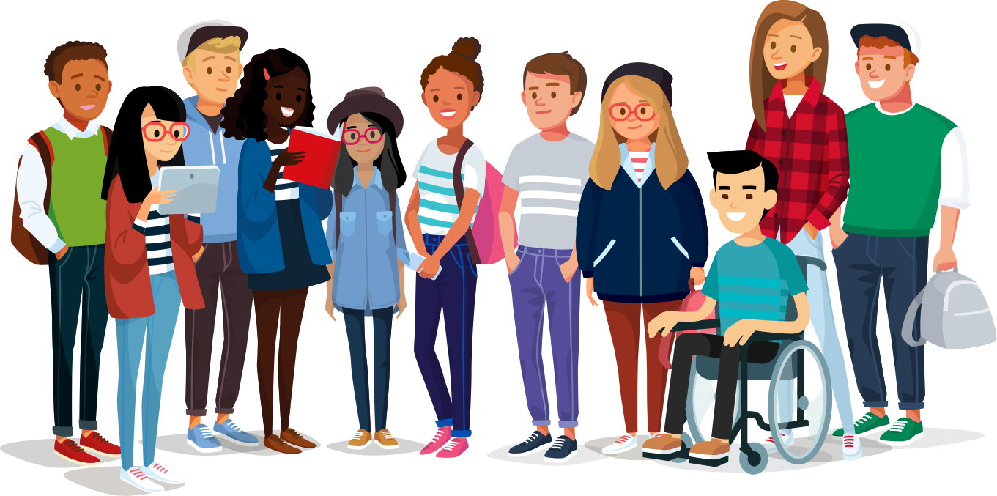
DO WE LIVE IN AN EQUAL SOCIETY?
What do you think?
Can you think of any examples of individuals or groups of people who have campaigned for equality in the past, or are campaigning for equality today?

Slide 12

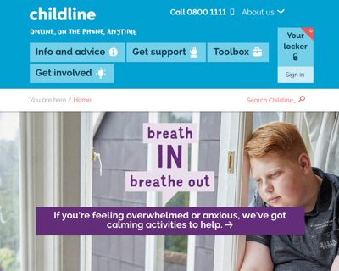

WHERE TO GET HELP
It’s never acceptable to be discriminated against.
If you are experiencing discrimination of any kind, speak to a trusted adult.
You can also find advice on these sites:
childline.org.uk
samaritans.org

Slide 13
ACTIVITY 2
INCLUSIVITY

Slide 14
EVERYBODY MEANS… EVERYBODY
Inclusivity means including people who might otherwise be excluded or marginalised.
Why do you think we need to make a special effort to ensure all people are included in society?

Slide 15

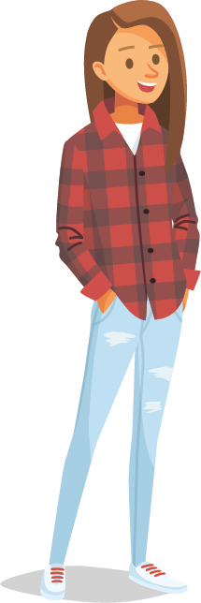
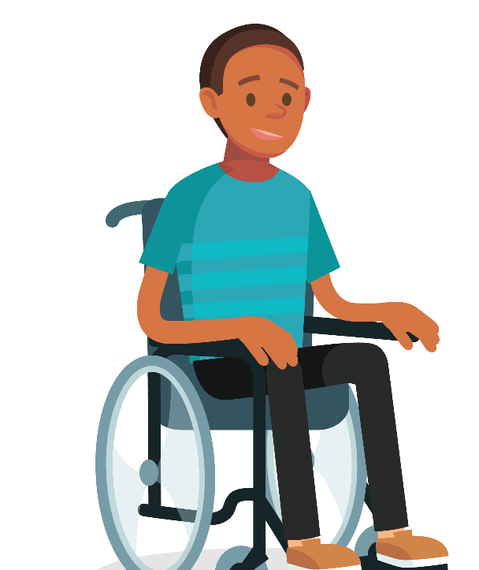

INCLUSIVITY IN ACTION
It’s not enough just to say that we are inclusive. We need to make sure our actions are inclusive too!
Look at the examples of young people who are experiencing barriers to inclusion on the Inclusivity in Action Activity Sheet. What can other students and the school do to help?
Be ready to share your ideas!
Extension: can you think of other groups with a protected characteristic who schools and students could act more inclusively towards? How could they do this?

Slide 16
ACTIVITY 3
CELEBRATING DIVERSITY

Slide 17
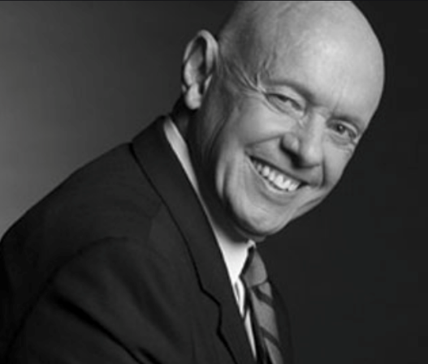
DIVERSITY MAKES US STRONGER
How do our differences make us stronger?
What if we were all the same?
How would that be a disadvantage?
“Strength lies in differences, not in similarities”
Stephen R. Covey

Slide 18
DIVERSITY DREAM TEAM
Working in groups, use the Diversity Dream Team Activity Sheet to create your own dream team. It could be a sports team, a dance troupe, a superhero squad – whatever you like!
You need to…
Decide on what your dream team do and their name.
Choose the diverse people who will be in your dream team. They could be famous people or made up characters. You could consider your mind maps and the protected characteristics to ensure you have a diverse team.
Explain what they are working towards together.
Show how their unique skills will complement each other.
Extension: how can the team set a positive example by being inclusive? Be ready to present your ideas!

Slide 19
PRESENT YOUR DIVERSITY DREAM TEAM
Tell the class:
Your team name and what they do.
Who’s in your team and how they’re diverse.
What they want to achieve.
How their unique skills will complement each other.
LET’S VOTE FOR OUR FAVOURITE TEAM!

Slide 20
ACTIVITY 4
#EqualityForAll

Slide 21

#EqualityForAll
Create a campaign for greater equality within your school or local community for a group of people with a protected characteristic.
What challenges does this group face?
What could help to ensure they are treated equally?
How would you end discrimination against them?

Slide 22
REFLECTION
WHAT CAN I DO?

Slide 23
WHAT CAN I DO?
Complete the sentence:
I will be respectful and inclusive to others by…

Slide 24
RELATIONSHIPS
ALL ABOUT INCLUSIVITY

