Slide 1
RELATIONSHIPS
ALL ABOUT BUILDING FRIENDSHIPS

Slide 2
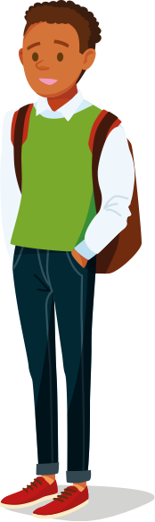
WHAT ARE WE GOING TO LEARN?
In this lesson, we will be looking
at why positive friendships are important and how they help us to
be ourselves. We will also look at friendships that are not so positive and what we can do to improve things or get help if we need it.

Slide 3
RESPECT. YOUR RULES.
Today, we’re going to be talking about sensitive topics. It’s really important that we all show each other respect. Use some of the words below to write your own three rules that you’d like everyone to follow.
HEAR
RESPECT
KIND
SENSITIVITY
EMPATHY
LISTEN
UNDERSTAND
SPEAK
Let’s share and agree on our ground rules.

Slide 4
STARTER ACTIVITY
POSITIVE FRIENDSHIPS

Slide 5
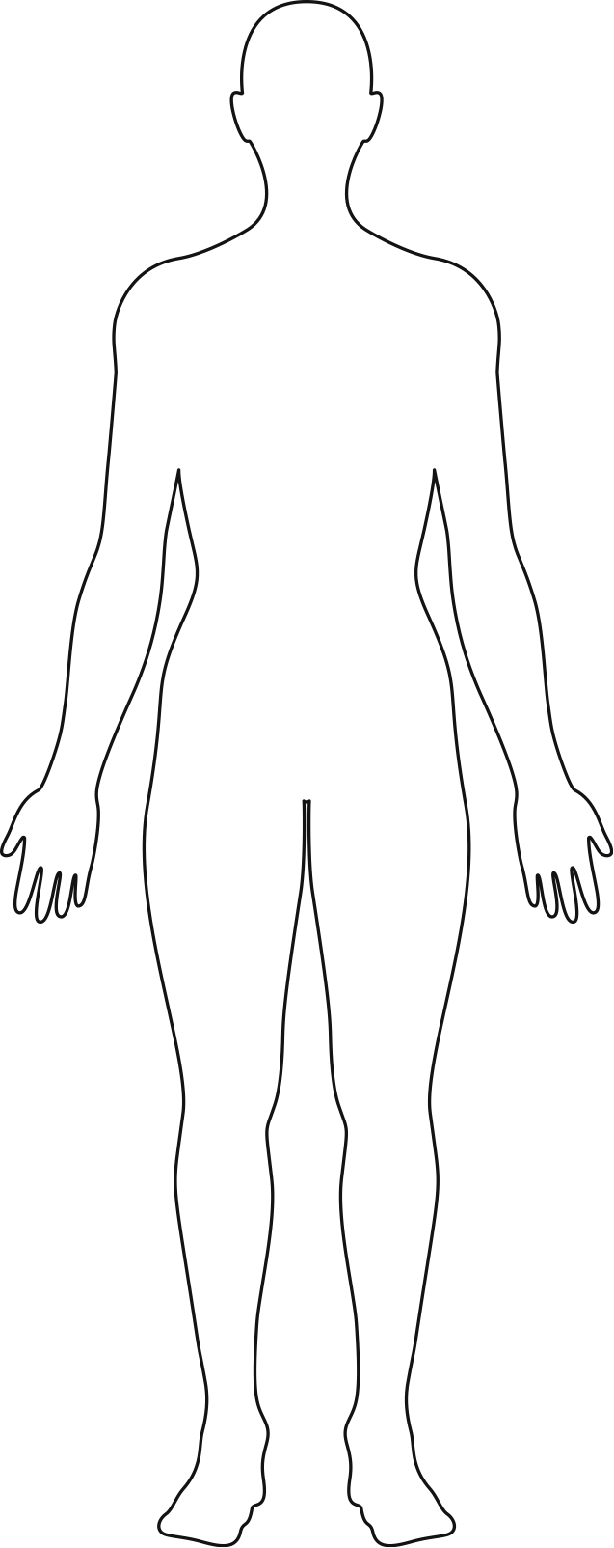
POSITIVE AND HEALTHY FRIENDSHIPS
Think of a good friend. Draw an outline of their body and write down a few adjectives to describe them inside.
Next, think about the things this friend does to help and support you. Write down examples of these outside the figure.
They listen to me
Loyal

Slide 6
ACTIVITY 1
FRIENDSHIP VALUES

Slide 7

FRIENDSHIPS
WHERE DO YOU STAND?
On the following slides there are statements about friendships. Get ready to move and stand in a position across the width of the classroom to show how much you agree or disagree with the statement.
Completely
agree
Completely
disagree

Slide 8
FRIENDSHIPS
WHERE DO YOU STAND?
#1
It’s ok for one person in a friendship to make all the rules and the other person to have to follow them.
Completely
agree
Completely
disagree

Slide 9
FRIENDSHIPS
WHERE DO YOU STAND?
#2
You should be able to get your own way in friendships, as long as you try hard enough.
Completely
agree
Completely
disagree

Slide 10
FRIENDSHIPS
WHERE DO YOU STAND?
#3
Listening is the most important ingredient of a
healthy friendship.
Completely
agree
Completely
disagree

Slide 11
FRIENDSHIPS
WHERE DO YOU STAND?
#4
If you have a serious argument in a friendship, then things can never be the same again.
Completely
agree
Completely
disagree

Slide 12
FRIENDSHIPS
WHERE DO YOU STAND?
#5
If you really care for your friend, then it’s ok to sometimes treat them badly - they know you are only joking.
Completely
agree
Completely
disagree

Slide 13
FRIENDSHIPS
WHERE DO YOU STAND?
#6
It’s impossible to have a good friendship without good communication.
Completely
agree
Completely
disagree

Slide 14
FRIENDSHIPS
WHERE DO YOU STAND?
#7
Keeping each others’ secrets is the number one rule
of friendships.
Completely
agree
Completely
disagree

Slide 15
FRIENDSHIPS
WHERE DO YOU STAND?
#8
Friendships are less important than other kinds of relationships, like family, or romantic relationships.
Completely
agree
Completely
disagree

Slide 16

WHAT MAKES A POSITIVE AND
HEALTHY FRIENDSHIP?
Using your drawing from the start of the lesson and the ideas
we’ve just discussed, work in groups to create a mind map
about what makes a healthy friendship.
Healthy
friendships
Extension:
are the qualities of
healthy friendships the
same for all relationships?
e.g. Family, romantic?
friendships

Slide 17
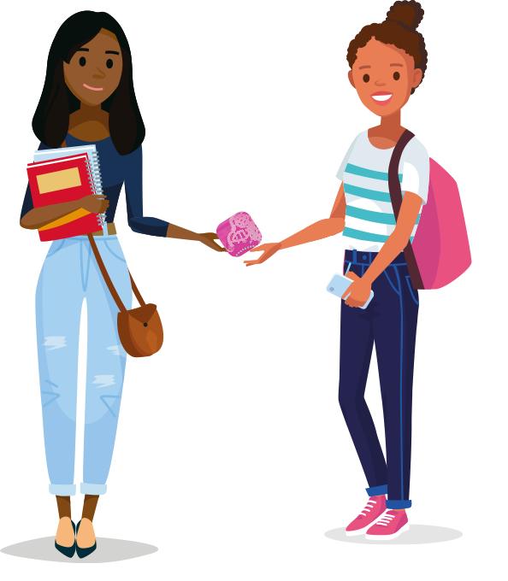
FRIENDS IN NEED
As you go through puberty, it’s important to have good friends
who you can lean on and who you can support too.
How could friends help if:
You’re worried that puberty hasn’t started yet for you.
You’ve been having intense mood swings that make you feel out of control.
Your period starts at school and you’re not prepared with any period protection.

Slide 18

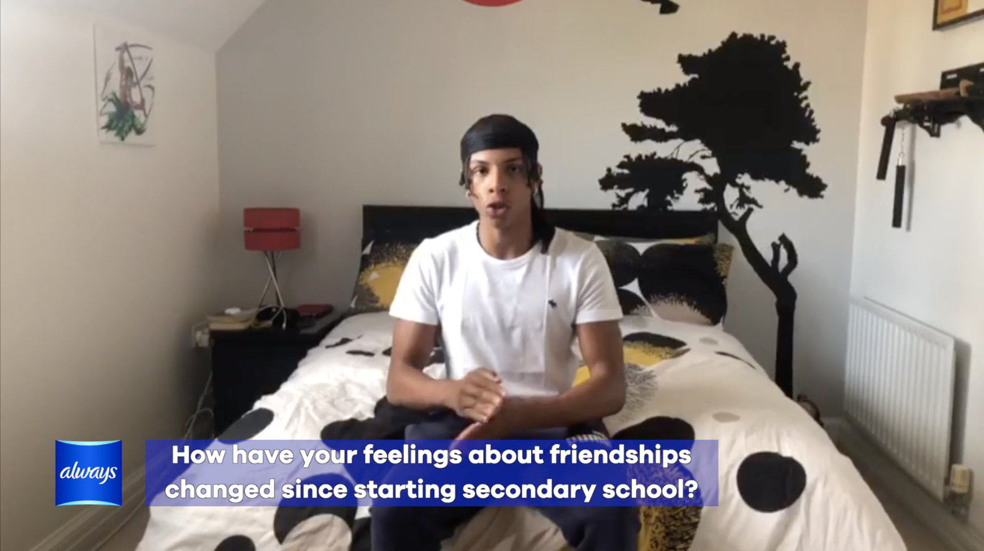

REAL TEENS ON RELATIONSHIPS
Watch the video of teens talking about their experiences
of different relationships. What stands out to you?
Do you have similar or different experiences?
Notes:
CLICK TO PLAY

Slide 19
ACTIVITY 2
SEE IT, STOP IT

Slide 20

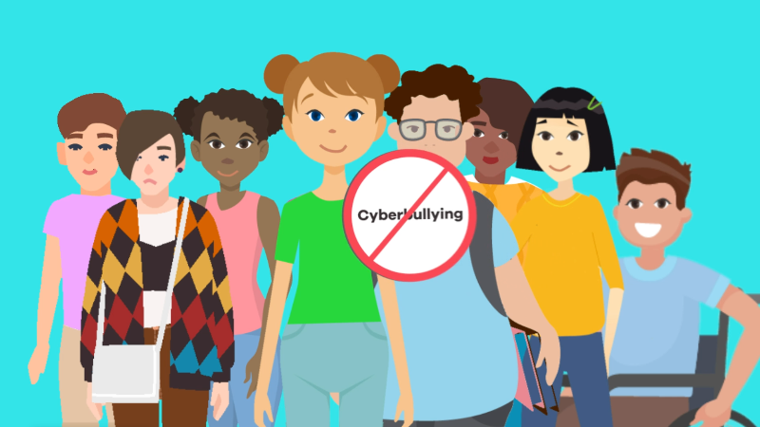
NEVER ACCEPT…
Whatever the relationship, there are some things that are never acceptable.
PHYSICAL ABUSE OR INTIMIDATION
Using or threatening force to hurt another person.
EMOTIONAL OR VERBAL ABUSE
Using words to deliberately upset or manipulate another person.
CYBERBULLYING
Using social media to abuse someone. Watch the What Is Cyberbullying? Video to find out more.
All of these kinds of abuse are unacceptable and against the law.
Notes:
CLICK TO PLAY

Slide 21
SEE IT, STOP IT
It’s important to speak out against any kind of bullying or abuse
so that it stops happening. But how can we do this effectively?
Using the See it, Stop it Activity Sheet, consider the different ways of responding to bullying.

Slide 22
SEE IT, STOP IT
Complete the table to show how and why different responses could help, and any potential disadvantages.
How could different responses help?
What would be the disadvantages?
Extension:
do you think people report bullying enough? Give reasons for your answer.

Slide 23


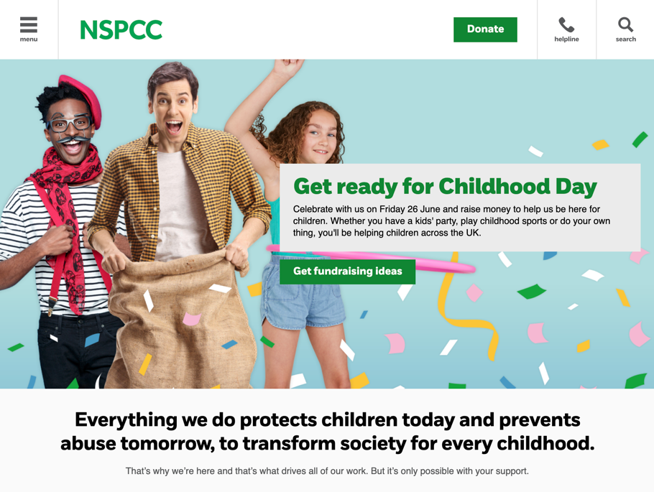
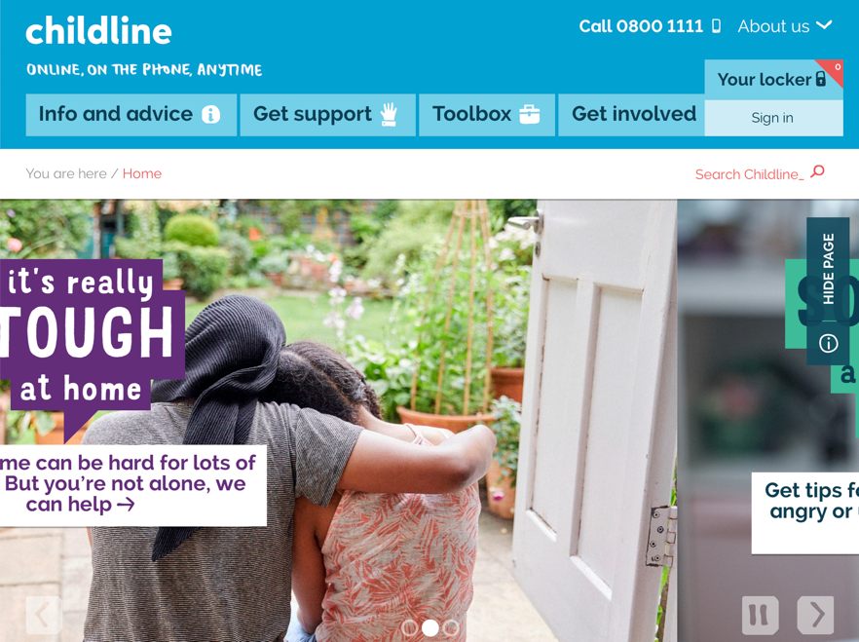
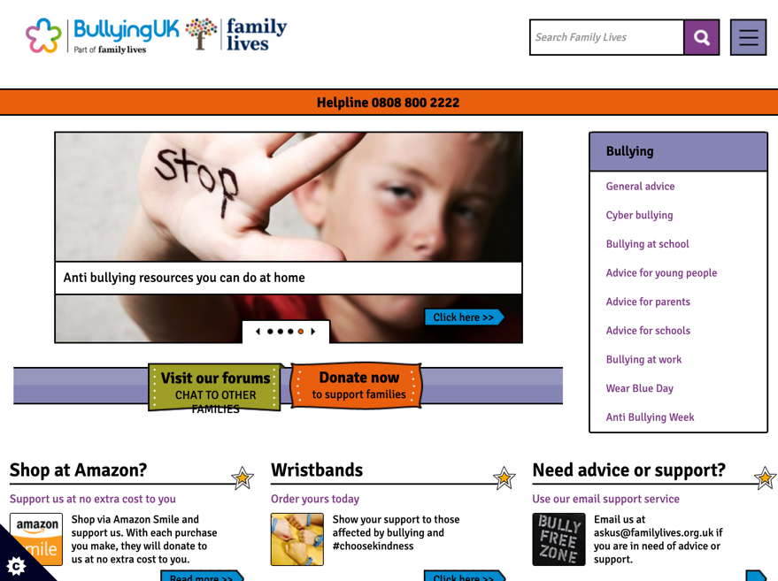
KNOWING WHERE TO GET HELP
If you’re worried about yourself or someone else,
speak to a trusted adult or teacher for advice.
You could also visit one of these websites for further support.
nspcc.org.uk
childline.org.uk
bullying.co.uk

Slide 24
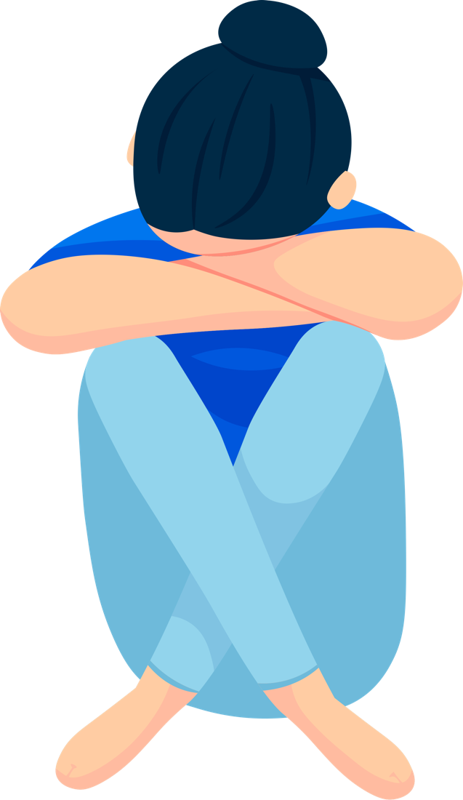




PUTTING A STOP TO BULLYING
Let’s look at two scenarios where people are being bullied.
Based on our discussion, what do you think would be the best
thing to do in each case?

Slide 25
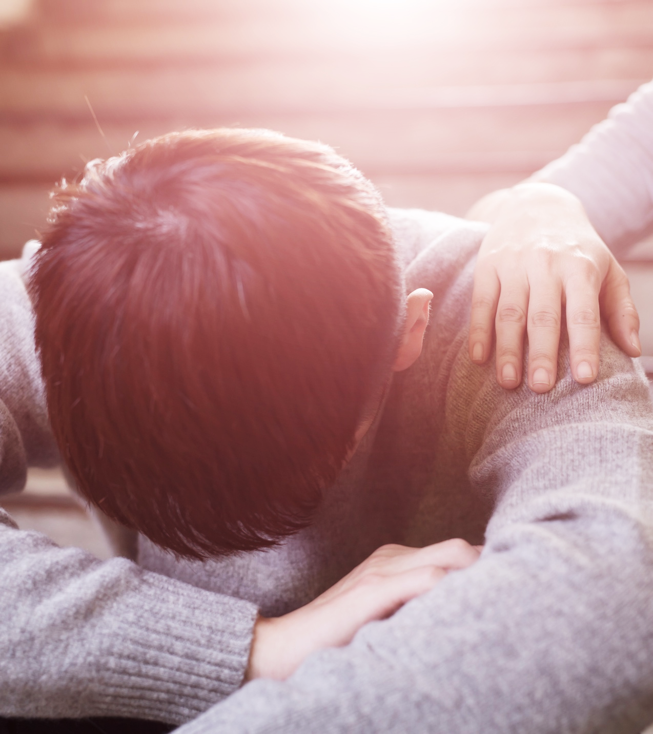
SCENARIO 1
WHAT WOULD YOU DO?
You’ve noticed that one of your friends
is not himself. He is really quiet and withdrawn. When you ask him what’s
up, he eventually admits that he’s been receiving abusive text messages, but he makes you swear not to tell anyone.

Slide 26
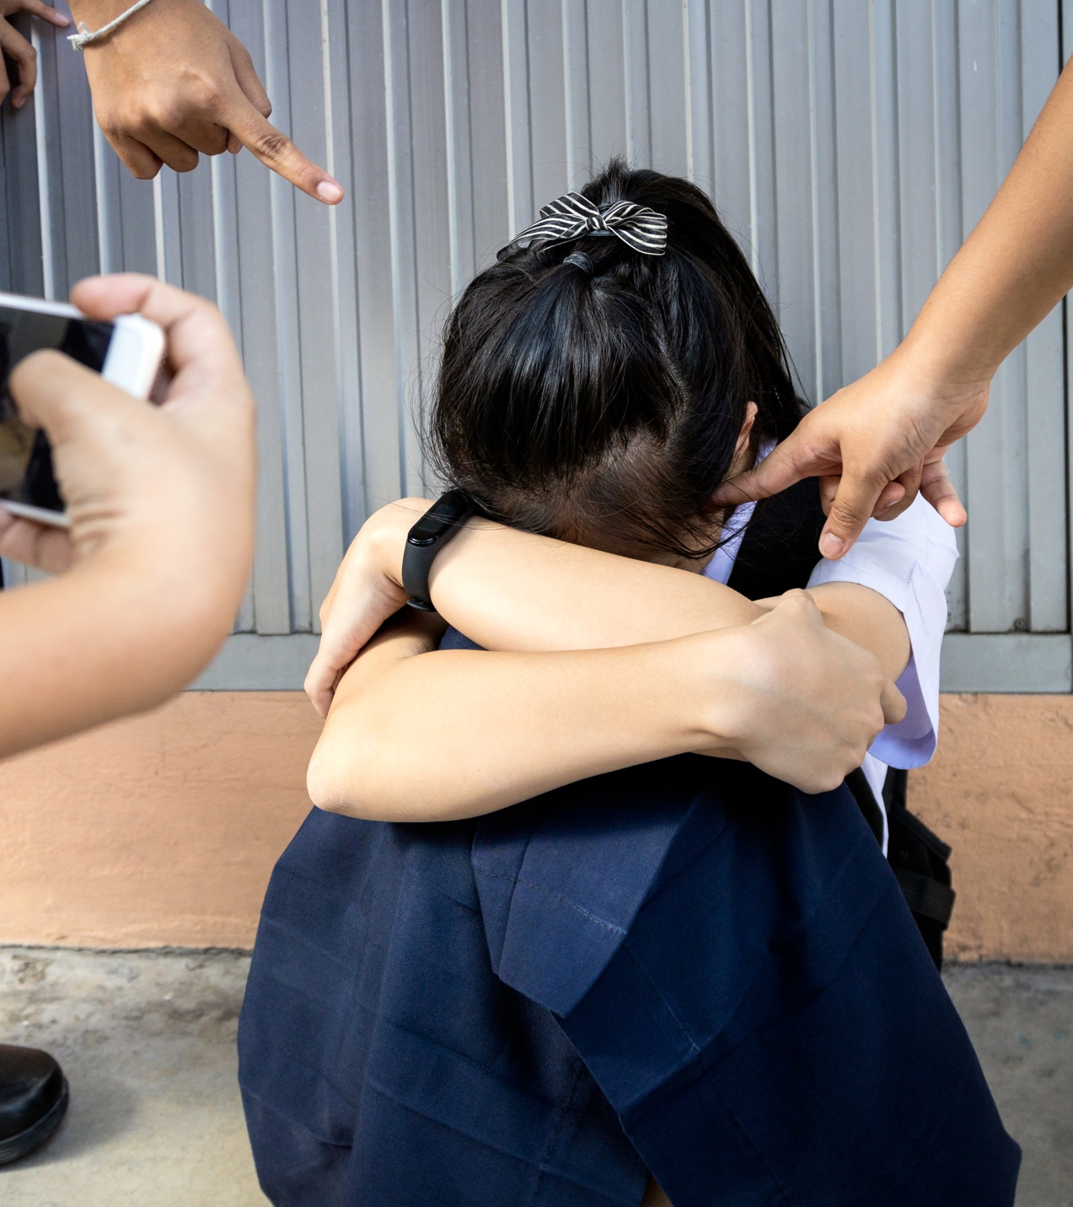
SCENARIO 2
WHAT WOULD YOU DO?
You are on the bus home and you see a girl in your school’s uniform (you don’t know her) get off, followed by a group of older kids. As she walks away you see they start to chase her and shout at her, but the bus pulls away so that’s all you see.

Slide 27
ACTIVITY 3
RESOLVING CONFLICT

Slide 28
RESOLVING CONFLICT
All friendships go through tough times. Sometimes, when we’re
upset, we say things we don’t mean. But it doesn’t have to signal
the end of a friendship.
Using the Resolving Conflict Activity Sheet, suggest alternatives to some of the phrases that can make a situation worse. See if you can
use positive language to turn things around.
Extension: in pairs, imagine a situation where two friends have fallen out. Try using some of your phrases to resolve the conflict in a role play.

Slide 29
ACTIVITY 4
GREAT FRIEND, WANTED

Slide 30
GREAT FRIEND, WANTED
Create a ‘wanted’ advert
for a great friend.
You should include:
Why are great friends important?
What does it take to be a great friend?
You could create a poster, write a film script or blog post, or use your own creative ideas!
Having your back
Getting you
Respect
Making you laugh
Knowing the limits
Trust

Slide 31
REFLECTION
BE A GREAT FRIEND

Slide 32
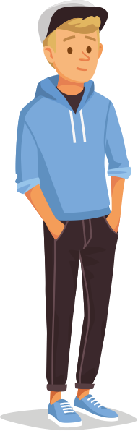
REFLECTION
Decide on three things you can do this week to be a great friend.
Extension: make a note of them and check in every few days to see if you’ve been able to make your friends feel valued.

Slide 33
RELATIONSHIPS
ALL ABOUT BUILDING FRIENDSHIPS

