Slide 1
WELLBEING
ALL ABOUT SOCIAL MEDIA

Slide 2

WHAT ARE WE GOING TO LEARN?
Today, we’re going to explore the emotional changes during puberty, how social media can lead us to have unrealistic expectations of ourselves and our bodies, how to be safe online and how to develop strategies to deal with any negativity.

Slide 3
RESPECT. YOUR RULES.
Today, we’re going to be talking about sensitive topics. It’s really important that we all show each other respect. Use some of the words below to write your own three rules that you’d like everyone to follow.
HEAR
RESPECT
KIND
SENSITIVITY
EMPATHY
LISTEN
UNDERSTAND
SPEAK
Let’s share and agree on our ground rules.

Slide 4
STARTER ACTIVITY
MY SOCIAL MEDIA
PLATFORMS

Slide 5
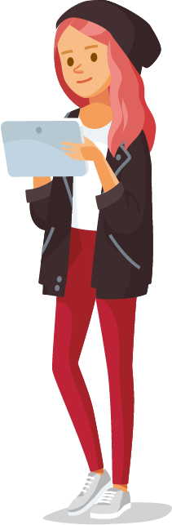






MY SOCIAL MEDIA PLATFORMS
Think about different social media platforms you use.
Which ones represent real life the best?
Which ones do you think are not so realistic?

Slide 6
ACTIVITY 1
MY EMOTIONS

Slide 7

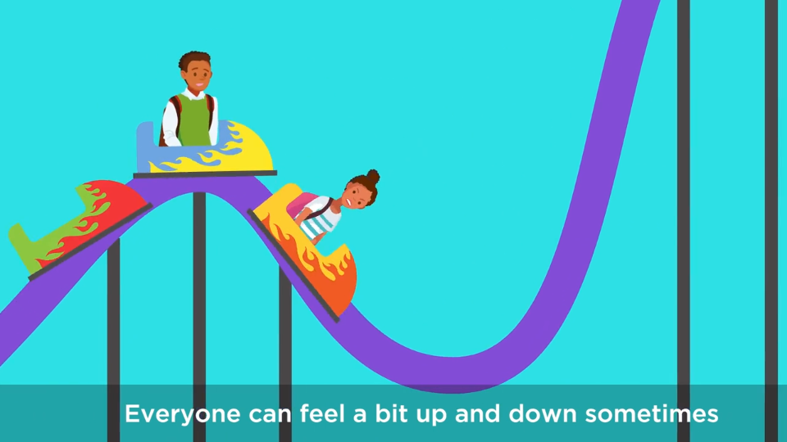

MY EMOTIONS
Puberty can be an interesting time. As well as changes on the outside, there's lots happening on the inside too. Let’s find out more by watching the Puberty – Emotions & Me Video.

Slide 8
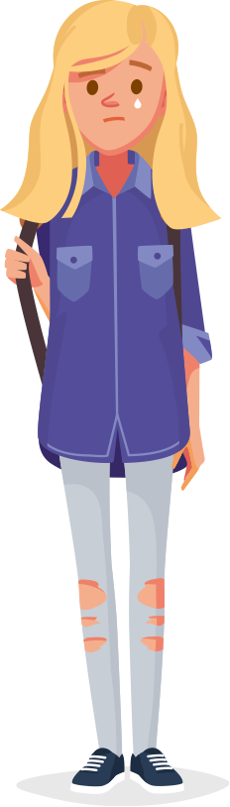
EMOTIONAL CHANGES AT PUBERTY
FEELING SELF-CONSCIOUS
PEER PRESSURE
MOOD SWINGS
A NEW PERSPECTIVE
PMS
How do these changes affect:
How we feel about ourselves?
Confidence levels?
Body image?
Decision making?

Slide 9
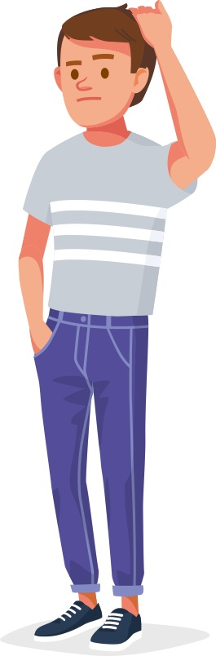
DEALING WITH EMOTIONS
FEELING SELF-CONSCIOUS
PEER PRESSURE
MOOD SWINGS
A NEW PERSPECTIVE
PMS
What were some of the suggestions made in the video to deal with these changes?
Can you think of any other things that might help?
Discuss as a group and be ready to feed back.

Slide 10

HOW CAN SOCIAL MEDIA AFFECT US?
Ajay is feeling a little self-conscious that he isn’t developing chest and shoulder muscles when some of his friends are.
He’s started following lots of men’s fitness and body building accounts on social media.
How could this make him feel?
What else could he do?

Slide 11
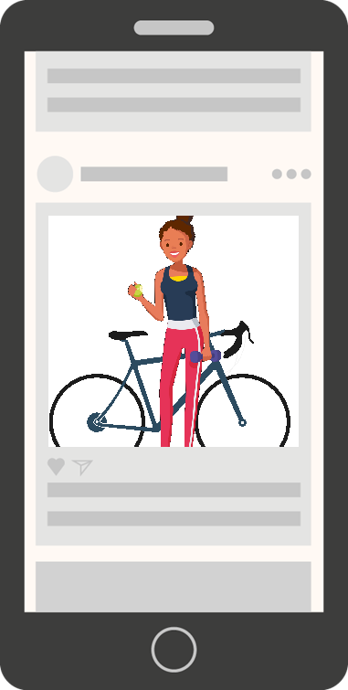
HOW CAN SOCIAL MEDIA AFFECT US?
Mia suffers badly with PMS every month. She gets cramps, bloating and feels sensitive.
She follows lots of social media accounts around fitness and motivation that tell her she should always push herself harder to reach her goals.
How could this make her feel when she has PMS?
What could she do about it?

Slide 12
ACTIVITY 2
ANALYSING SOCIAL MEDIA

Slide 13

DOES SOCIAL MEDIA SET UNREALISTIC EXPECTATIONS?
Show your opinion by standing along the continuum based on how far you agree or disagree.
Be ready to justify your opinion.
NO
YES

Slide 14
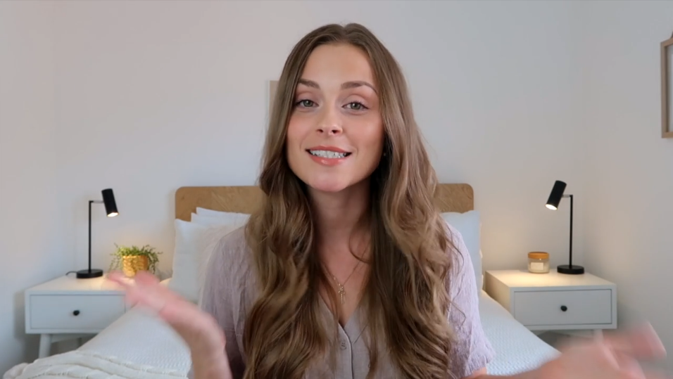

SOCIAL MEDIA & WELLBEING
Social media can be addictive and does not always represent reality, you should never compare your life with what you see online and you should feel able to disconnect and spend time offline with friends and family.
In this video, hear how Jade Billington deals with the pressures of social media.
Notes:
CLICK TO PLAY

Slide 15
SOCIAL MEDIA THE GOOD AND BAD
Think about the role of social media in your life. What are its positive and negative aspects and how do they make you feel? Add them to the Analysing Social Media Activity Sheet.
POSITIVE ASPECTS
NEGATIVE ASPECTS
EXAMPLE I can easily connect with people around the globe who share my interests – makes me feel like I’m part of a community
EXAMPLE Shows so many ‘perfect’ bodies – can make me feel like I’m not good enough

Slide 16
ANALYSING SOCIAL MEDIA
When we look at social media images, it’s important to remember they’re created for a purpose. To analyse them, we should always ask:
Who created this message and why?
What techniques are used to attract my attention?
How might other people see this differently to me?
What social values or norms does it represent, or reject?
You can apply this analysis to other forms of media too, like TV adverts.

Slide 17
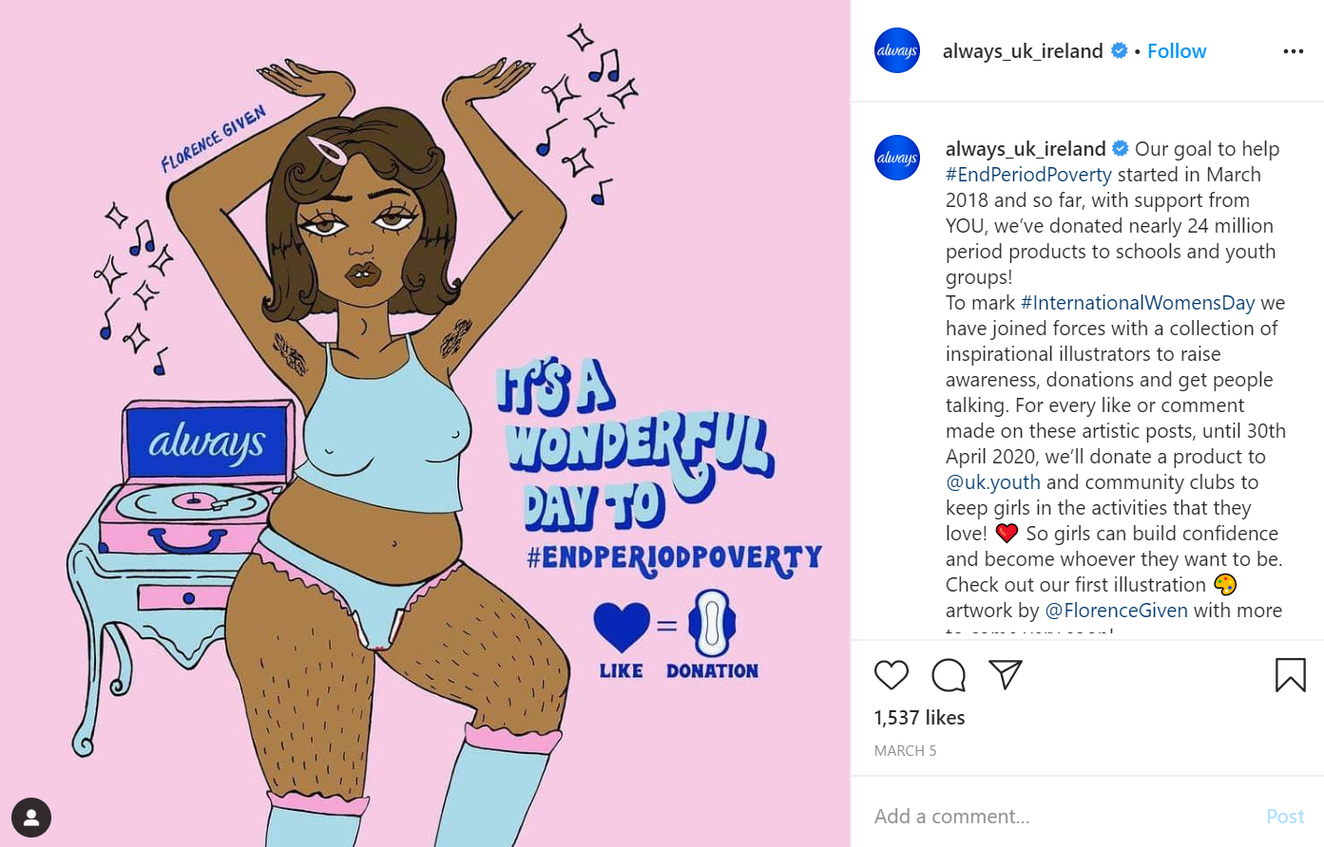

ANALYSING A POST
Annotate on your Analysing Social Media Activity Sheet and be ready to share your thoughts.
Extension: think of brands you use or follow. How do they represent themselves? Use the questions to analyse their advertising campaigns.
Notes:
Annotate on your Analysing Social Media Activity Sheet and be ready to share your thoughts.

Slide 18

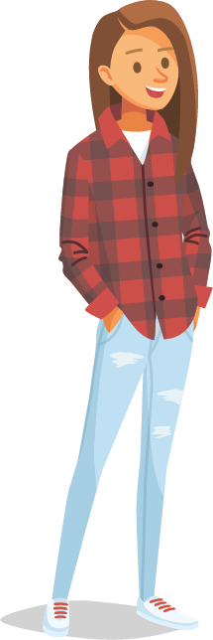
MY SOCIAL MEDIA CAMPAIGN
On the Analysing Social Media Activity Sheet, create a post that champions a cause you believe in. Draw the image you would use, write the caption and annotate your post to explain how and why this would send a positive message to the world.
Possible causes
Mental health
Body image
Sport and fitness
Attitudes towards periods
What else can you think of?

Slide 19
MY SOCIAL MEDIA STRATEGY
What can you do to make sure you have a healthy relationship with social media?
Suggest three tips to help you and add them to the Analysing Social Media Activity Sheet.
You could consider:
Time spent online
Who you follow
Time spent reading posts versus reading comments
How and when to react to comments
Keeping track of how social media makes you feel
Occasions when you may want to spend less time on social media

Slide 20
ACTIVITY 3
STAYING SAFE ON SOCIAL MEDIA

Slide 21
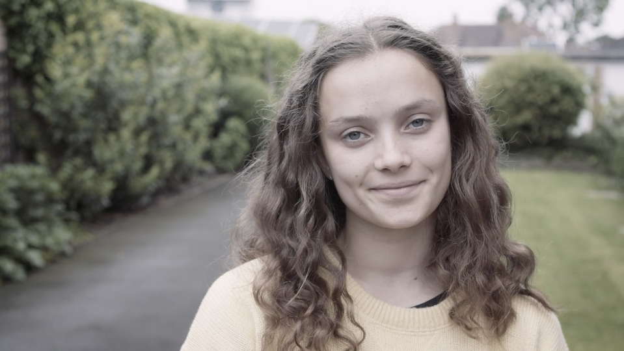
ALEXA’S STORY
Watch Alexa’s story about her experience with social media.
Pause when indicated and complete the activity on the next slide before watching the rest.
Notes:
CLICK TO PLAY

Slide 22

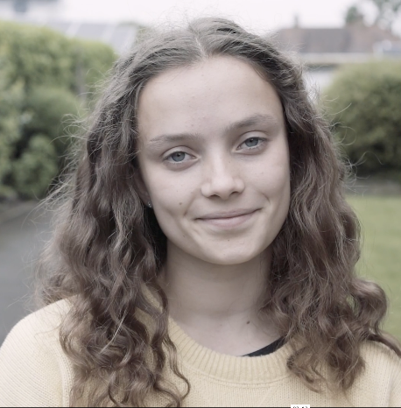
ALEXA’S STORY
What could Alexa do?
Come up with a plan of action listing three things she could do to improve the situation and help rebuild her confidence. Discuss in groups before feeding back to the class.
Now go back and watch the end of the video to find out what happened to Alexa.
Notes:
CLICK TO PLAY

Slide 23
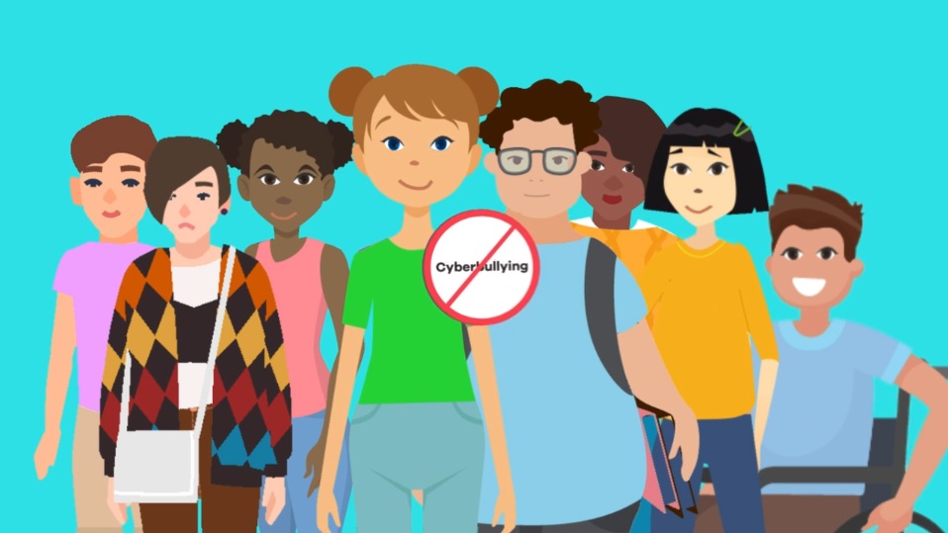
CYBERBULLYING & GETTING HELP
There are many forms of online bullying.
Watch the What Is Cyberbullying? Video to learn more and find out how to get help.
If you, or someone you know, are being abused online, you could:
Speak to a trusted adult
Speak to a teacher
Go to Childline.com a free service for young people
Notes:
CLICK TO PLAY

Slide 24
ACTIVITY 4
GUIDE TO SOCIAL MEDIA

Slide 25

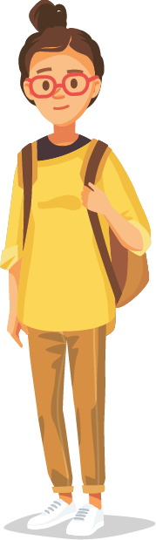
SOCIAL MEDIA EXPLAINED
Create a guide to social media for a student who is about to turn 13 and can legally have their own accounts.
You could include:
Different channels and what they are used for.
Positive and negative aspects of social media.
How to enjoy social media without letting it affect your self-confidence.
Where to go to get help if you need it.

Slide 26
REFLECTION
SAFER SOCIAL MEDIA

Slide 27
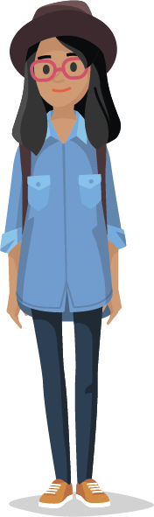
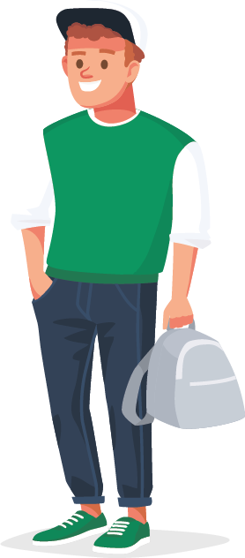
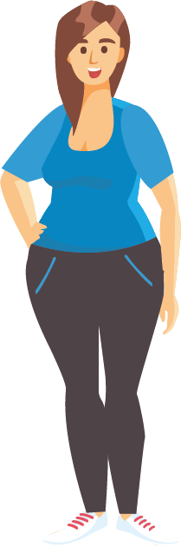
A SAFER PLACE
What is the one thing that would make social media a better and safer place? How would you persuade someone to do it?
Share with three other people, and decide which are your favourite ideas, then share with the class.

Slide 28
WELLBEING
ALL ABOUT SOCIAL MEDIA

