Slide 1
PUBERTY
ALL ABOUT PUBERTY AND REPRODUCTION

Slide 2
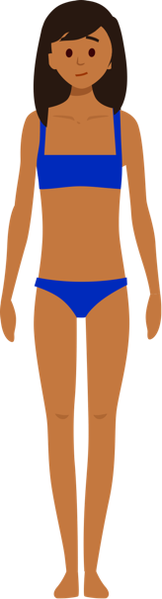
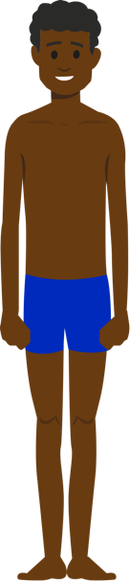
WHAT ARE WE GOING TO LEARN?
In today’s lesson, we’re going to review the changes that happen during puberty and explore how babies are made and the impact they have on a parent’s life. We’ll also explore different period products and when they can be used.

Slide 3
RESPECT. YOUR RULES.
Today, we’re going to be talking about sensitive topics. It’s really important that we all show each other respect. Use some of the words below to write your own three rules that you’d like everyone to follow.
HEAR
RESPECT
KIND
SENSITIVITY
EMPATHY
LISTEN
UNDERSTAND
SPEAK
Let’s share and agree on our ground rules.

Slide 4
STARTER ACTIVITY
ATTITUDES TO PUBERTY

Slide 5
ATTITUDES TO PUBERTY
Read the following statistics and discuss your thoughts about them with another student.
36% of males feel too embarrassed to talk to anyone about the changes they went through during puberty.
48% of females feel embarrassed by their period, with a high of 56% among 14-year-olds.
Why do you think many young people feel this way?
What do you think needs to change in order for people to feel differently about periods and puberty?

Slide 6
ACTIVITY 1
PUBERTY QUIZ
HOW MUCH DO YOU KNOW?

Slide 7

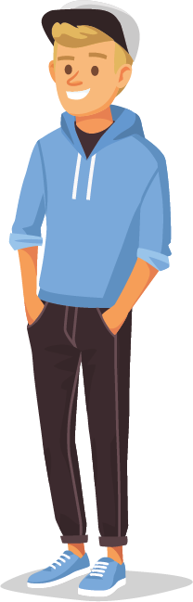
PUBERTY ‘THREE THINGS’ QUIZ
Work in teams of three (as far as possible).
Each team needs a white board.
For each question, you’ll need to come up with three pieces of information.
For some questions there may be exactly three right answers. For others, there may be more.
You can score up to three points per question. Keep a tally of your score.
LET’S GO

Slide 8
PUBERTY ‘THREE THINGS’ QUIZ
#1
Name three physical changes that happen only to females at puberty.
Breasts develop
Hips widen
Labia change
Menstruation begins
Vaginal discharge starts

Slide 9
PUBERTY ‘THREE THINGS’ QUIZ
#2
Name three physical changes that happen only to males at puberty.
Hair grows on face
Adam's apple grows
Voice breaks and deepens
Shoulders and chest become muscular
Erections/ejaculation begins
Penis and testes grow

Slide 10
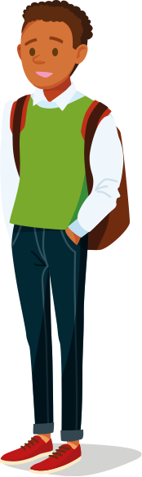
PUBERTY ‘THREE THINGS’ QUIZ
#3
Name three physical changes that happen to everyone at puberty.
Grow taller
Skin becomes oilier
May start to get spots
Start to sweat more
Develop body odour
Hair grows on body
Brain develops

Slide 11
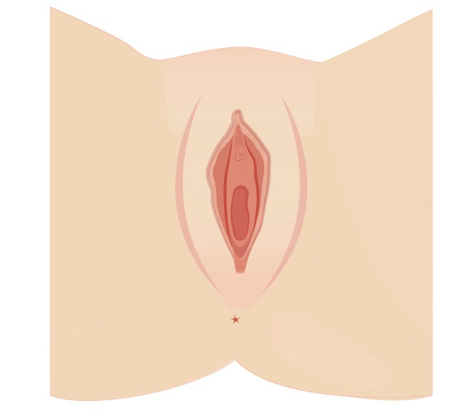
PUBERTY ‘THREE THINGS’ QUIZ
#4
Name the three openings in the female diagram below.
Urethral opening
Vaginal opening
Anus

Slide 12
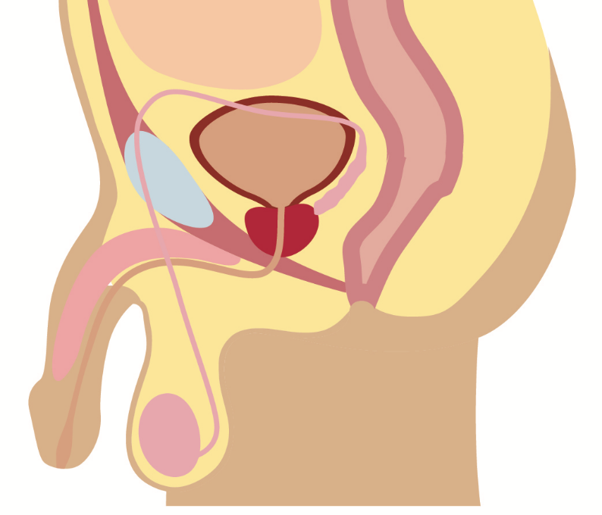
PUBERTY ‘THREE THINGS’ QUIZ
#5
Name three parts of the male diagram below.
Bladder
Prostate gland
Rectum
Urethra
Anus
Penis
Testis
Scrotum

Slide 13
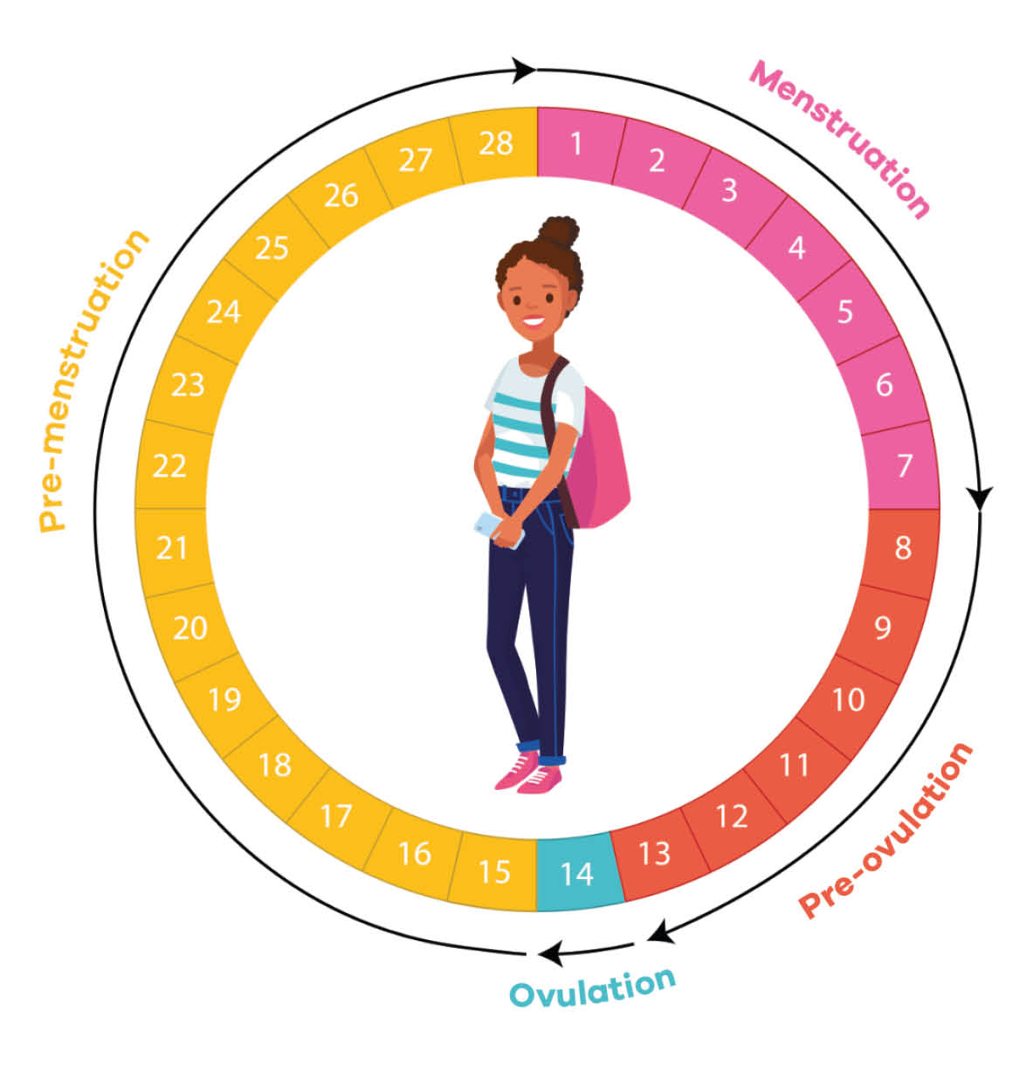
PUBERTY ‘THREE THINGS’ QUIZ
#6
List three things that happen during the menstrual cycle.
The lining of the uterus breaks down
It leaves the body as menstrual fluid
The lining of the uterus (endometrium) thickens
An egg is released from the ovary (ovulation)
It travels along the fallopian tube towards the uterus
The egg could be fertilised by a sperm
The fertilised egg could implant in the wall of the uterus starting a pregnancy
Vaginal discharge increases
Females may experience PMS

Slide 14
HOW DID YOU DO?
Add up your points out of 18 to see how you did.
16+ Puberty Pros There’s not much about puberty you don’t know. Great job!
13 – 15 Feeling Confident You’ve got a great understanding of most of the changes and just need to brush up on a few facts.
10 – 12 Good Grasp You’ve got a good understanding of the changes at puberty.
6 – 9 Not So Sure You know the basics, but there’s still lots to learn. Remind yourself of the essential facts.
0 – 5 Do Your Homework! It’s important to be prepared for puberty. Take some time to learn what you need to know.

Slide 15


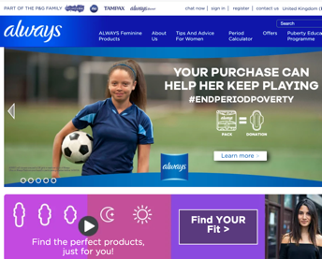
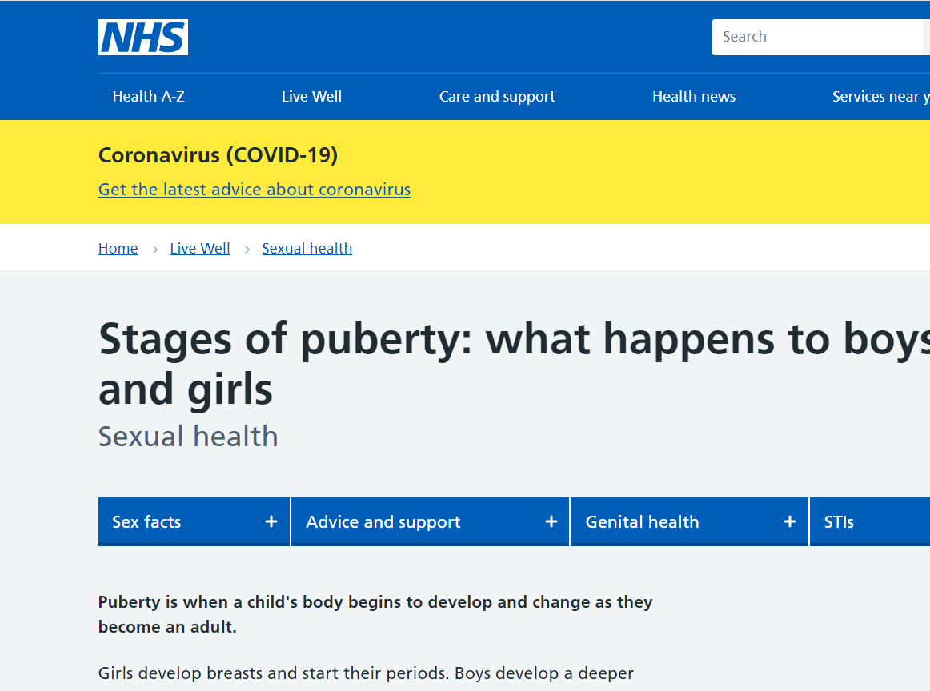
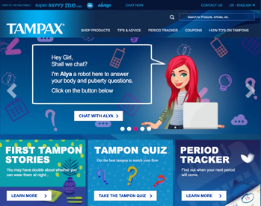
WHERE TO FIND OUT MORE
There are plenty of ways you can find out more and get answers to any questions you might have. Speak to a trusted adult or teacher, or visit one of these websites for further support.
always.co.uk
nhs.uk
tampax.co.uk

Slide 16
ACTIVITY 2
FERTILITY AND MAKING BABIES

Slide 17

HOW ARE BABIES MADE?
In pairs, imagine that you have to explain to a primary school pupil how babies are made.
What are the facts and how would you explain them in a way that they could understand?
Be ready to share your ideas!
For an extra challenge, explain it to an alien!

Slide 18

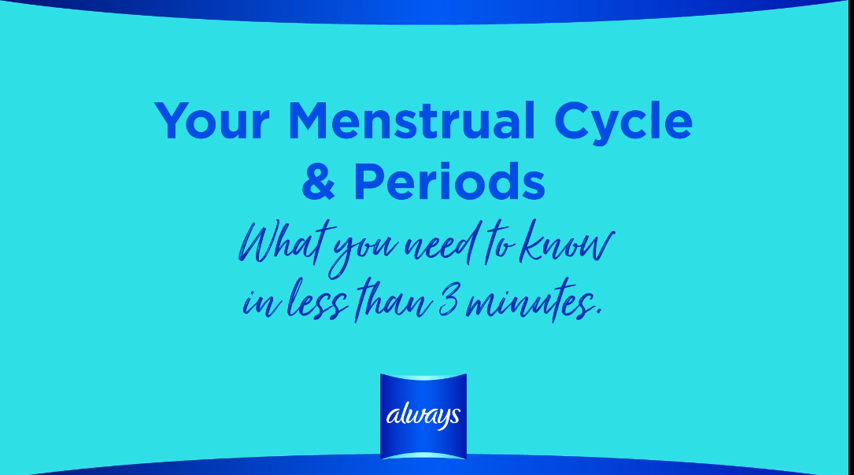

REPRODUCTION AND THE MENSTRUAL CYCLE
Let’s watch the Your Menstrual Cycle & Periods In 3 Minutes Video and see how accurate your ideas were. Pay close attention to how a pregnancy starts and when this happens in the cycle.
Notes:
CLICK TO PLAY

Slide 19


MAKING BABIES - TRUE OR FALSE?
#1
You have to have sexual intercourse in order to conceive (make a baby).
FALSE
While many babies are conceived through sexual intercourse, not all of them are. Some babies are conceived through fertility treatment such as IVF (in vitro fertilisation), where a fertilised egg (embryo) is implanted into the uterus.

Slide 20

MAKING BABIES - TRUE OR FALSE?
#2
You can only reproduce if you are in a heterosexual couple.
FALSE
Many same sex couples use fertility treatments to conceive and start a family. They can use donor eggs or sperm and gay men can use a surrogate to carry the pregnancy.

Slide 21


MAKING BABIES - TRUE OR FALSE?
#3
You only need to have sex once without protection to be at risk of becoming pregnant.
TRUE!
Although there are times during the menstrual cycle where a female is more likely to conceive, it is important to always use protection, unless you want to have a baby.

Slide 22
ONCE A BABY ARRIVES
Once a baby is born, new parents need to make sure they can care for them.
In your pairs, think about:
What kind of environment does a baby need?
What special equipment do they need?
What about the costs of having a baby?
How do they need to be looked after?
What might be challenging about looking after a baby?

Slide 23

PREPARING FOR A BABY
Meet Alicia and Milly. Alicia is pregnant and they are looking forward to their first child together.
Alicia is a nurse and Milly is a personal trainer. They live in a one-bedroom flat in the city and they enjoy going to music gigs and cycling.
How do you think their lives will change once the baby arrives? What can they do to prepare?

Slide 24
ACTIVITY 3
PERIOD PROTECTION – WHAT AND WHEN

Slide 25

I DON’T HAVE PERIODS – DO I REALLY NEED TO KNOW THIS?
It’s important that everyone understands the menstrual cycle.
WHY?
It’s an important biological process that enables human reproduction – i.e. making babies!
If you do not have a female reproductive system, there are plenty of important people in your life that do (mum, sisters, friends and - perhaps one day - partners, or daughters). So, it’s important that you understand the menstrual cycle and how you can support and empathise, when they need you to.

Slide 26

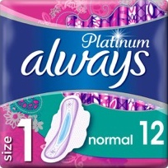
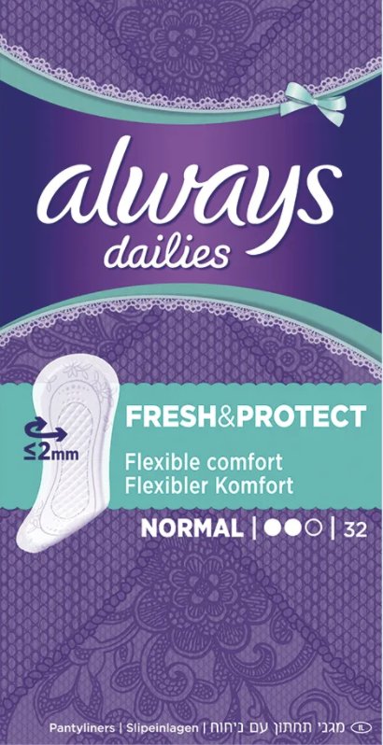
PERIOD PROTECTION
When someone has a period, menstrual fluid leaves the body through the vagina, so period protection will need to be used.
There are lots of different types of period protection products. It can seem a little confusing at first, so let's find out about the different types of period products available.

Slide 27
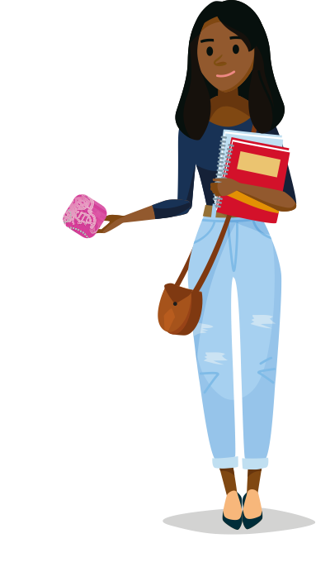
PERIOD PROTECTION INVESTIGATION
In small groups, you will be given information on one type of period product – either pads, tampons, panty liners, menstrual cups or period pants.
Complete the section of the Period Protection Investigation Activity Sheet for the one period product you have been given.
Groups will then present their findings back to the class. As you listen, complete the rest of the sheet.

Slide 28

PERIOD PROTECTION INVESTIGATION
Describe what this period protection looks like.
How does it work?
How is it used?
Are there different types or varieties? What are they for?
How do you dispose of it?
Extension: what are the benefits and disadvantages of this period product?

Slide 29

TSS - WHAT IS IT?
TSS – or Toxic Shock Syndrome – is a rare condition that can be fatal. Anyone can get TSS but it has been linked with tampon use, so it’s important to know the signs.
TSS is treatable, but the earlier you catch it the better. Here’s what you need to watch out for:
• Sudden high fever (usually over 39°C)
• Dizziness
• Vomiting
• Muscle ache
• Diarrhoea
• Fainting
• Sunburn-like rash
If you think you may have TSS, you should talk to a trusted adult and see a doctor

Slide 30

ENSURING EVERYONE HAS ACCESS TO PERIOD PRODUCTS
Unfortunately, not everyone can afford the period protection they need. How do you think that could affect someone?
Everyone deserves to have access to the products they need.
If you’re affected, or know a friend in need, speak to a teacher to get help.

Slide 31

PERIOD ADVICE
Look at the three scenarios on the following slides. What would your advice be to the young people shown?
Discuss with a partner and be ready to share your answers with the class.

Slide 32
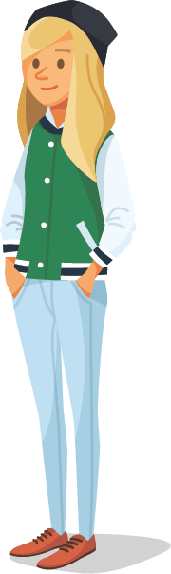
SCENARIO 1 - LAYLA
LAYLA is 13 and started her period six months ago. It’s still quite irregular so she doesn’t know when it will happen. She is in her local swimming club and trains three times a week, but she feels she has to stop going when she’s on her period. She doesn’t want to miss out on training. Is there anything she could do?
It can be hard when you don’t know when your period will start. Layla could always keep period protection handy so she’s prepared. She could also use a tracking app so she knows when her periods become regular.
She doesn’t have to stop swimming when she’s on her period. Layla can try using either tampons or a menstrual cup and keep training as usual.

Slide 33
SCENARIO 2 - FINLAY
FINLAY is 14 and is a transgender boy. He has started having periods and it’s something that he finds hard to deal with. Recently, someone saw a pad in his bag and since then he’s received comments from other students. He’s been told he’s disgusting and once someone moved away from him at lunchtime. What advice would you give him?
Period shaming or gender-based bullying is never acceptable. Finlay should speak to a teacher or trusted adult who can help make sure the bullying stops.
He should try to stay positive by reminding himself of all the things he’s happy and proud about.
Finlay could talk to a close friend or a charity like Mermaids (mermaidsuk.org.uk) who offer free support and advice.

Slide 34
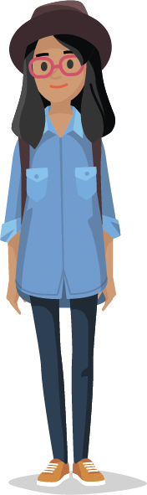
SCENARIO 3 - INDRA
INDRA is 11 and lives with her dad and two younger brothers. Her dad has recently lost his job and they are struggling to afford basic necessities. She started her period last month but there was no money for period products so she used tissue instead. Her period is due again soon. What could she do?
Everyone who needs them should have access to period products. The government now supplies schools and youth clubs with free period products for those in need.
Indra should speak to a teacher to find out how to access period products at school.

Slide 35
ACTIVITY 4
PUBERTY AWARENESS CAMPAIGN

Slide 36
PUBERTY AWARENESS CAMPAIGN
Write an advert informing younger students about one or more of the changes they will experience at puberty.
It could be based on physical changes, emotional changes, periods and period products or anything else you think is important for young people to know about.
What do they need to know about the change?
What tips do you have for dealing with this change?

Slide 37
REFLECTION
PUBERTY ADVICE

Slide 38
REFLECTION
Where could someone go to get help or advice if they’re concerned about anything related to puberty? Discuss with another student.
Think about:
In school
Out of school
Online

Slide 39
PUBERTY
ALL ABOUT PUBERTY AND REPRODUCTION

